Slide 2
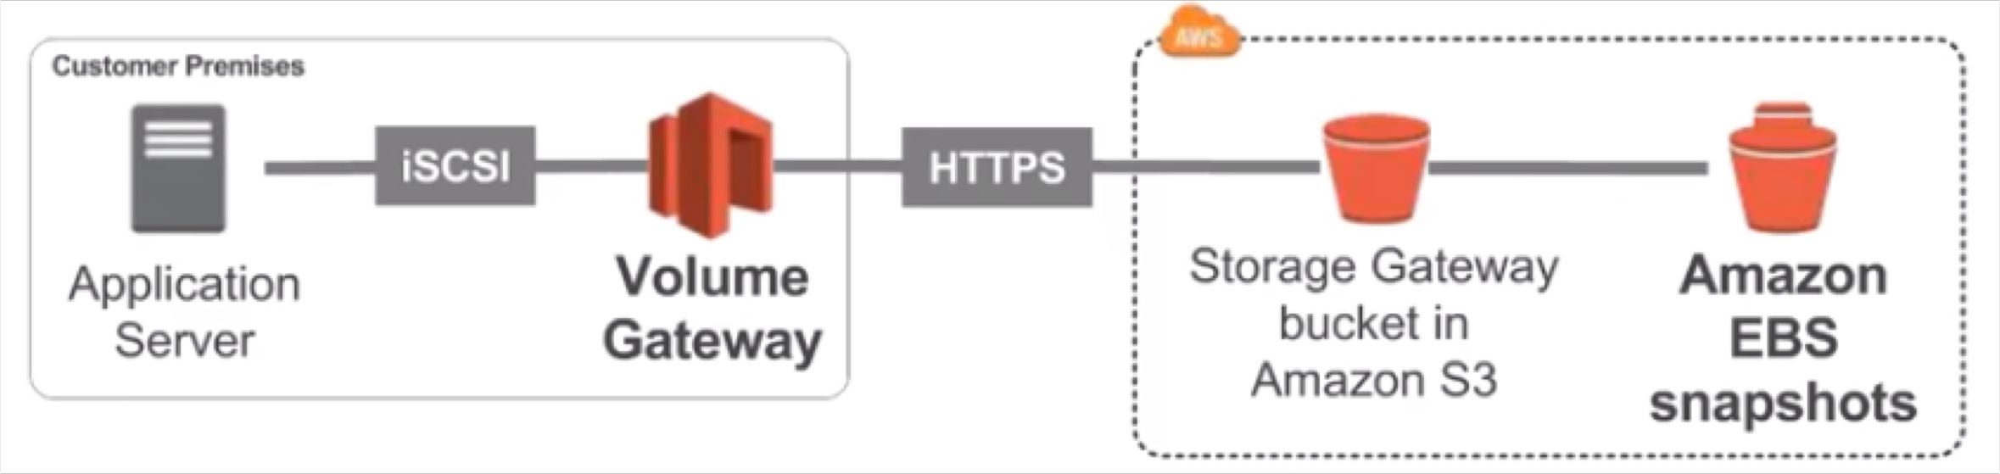
Volume Gateway
NOT FOR DISTRIBUTION © Stephane Maarek www.datacumulus.com
Block storage using iSCSI protocol backed by S3
Backed by EBS snapshots which can help restore on-premise volumes!
Cached volumes: low latency access to most recent data
Stored volumes: entire dataset is on premise, scheduled backups to S3
© Stephane Maarek

Slide 3
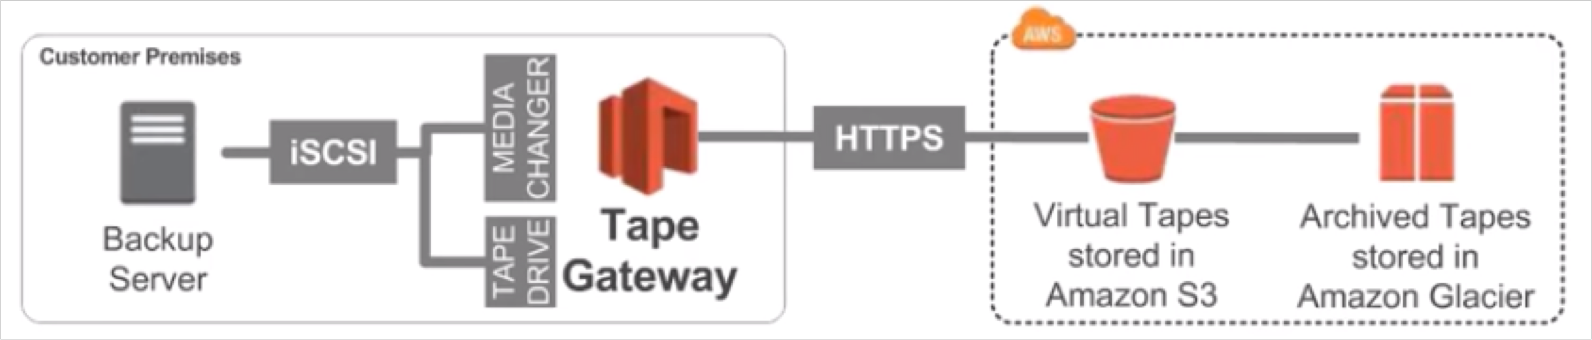
Tape Gateway
NOT FOR DISTRIBUTION © Stephane Maarek www.datacumulus.com
Some companies have backup processes using physical tapes (!)
With Tape Gateway, companies use the same processes but in the cloud
Virtual Tape Library (VTL) backed by Amazon S3 and Glacier
Back up data using existing tape-based processes (and iSCSI interface)
Works with leading backup software vendors
© Stephane Maarek

Slide 4
AWS Storage Gateway Summary
NOT FOR DISTRIBUTION © Stephane Maarek www.datacumulus.com
Exam tip: Read the question well, it will hint at which gateway to use
On premise data to the cloud => Storage Gateway
File access / NFS => File Gateway (backed by S3)
Volumes / Block Storage / iSCSI => Volume gateway (backed by S3 with EBS snapshots)
VTL Tape solution / Backup with iSCSI = > Tape Gateway (backed by S3 and Glacier)
© Stephane Maarek

Slide 5

AWS Athena
NOT FOR DISTRIBUTION © Stephane Maarek www.datacumulus.com
Serverless service to perform analytics directly against S3 files
Uses SQL language to query the files
Has a JDBC / ODBC driver
Charged per query and amount of data scanned
Supports CSV, JSON, ORC, Avro, and Parquet (built on Presto)
Use cases: Business intelligence / analytics / reporting, analyze & query VPC Flow Logs, ELB Logs, CloudTrail trails, etc...
Exam Tip: Analyze data directly on S3 => use Athena
© Stephane Maarek

Slide 6
NOT FOR DISTRIBUTION © Stephane Maarek www.datacumulus.com
AWS Integration & Messaging
SQS, SNS & Kinesis
© Stephane Maarek

Slide 7
Section Introduction
NOT FOR DISTRIBUTION © Stephane Maarek www.datacumulus.com
When we start deploying multiple applications, they will inevitably need to communicate with one another
There are two patterns of application communication
1) Synchronous communications (application to application)
2) Asynchronous / Event based (application to queue to application)
Buying Service
Shipping Service
Buying Service
Queue
Shipping Service
© Stephane Maarek

Slide 8
Section Introduction
NOT FOR DISTRIBUTION © Stephane Maarek www.datacumulus.com
Synchronous between applications can be problematic if there are sudden spikes of traffic
What if you need to suddenly encode 1000 videos but usually it’s 10?
In that case, it’s better to decouple your applications,
using SQS: queue model
using SNS: pub/sub model
using Kinesis: real-time streaming model
These services can scale independently from our application!
© Stephane Maarek

Slide 9


AWS SQS
What’s a queue?
NOT FOR DISTRIBUTION © Stephane Maarek www.datacumulus.com
Consumer
Producer
Consumer
Producer
Send messages
Poll messages
Consumer
Producer
SQS Queue
Consumer
© Stephane Maarek

Slide 10

AWS SQS – Standard Queue
NOT FOR DISTRIBUTION © Stephane Maarek www.datacumulus.com
Oldest offering (over 10 years old)
Fully managed
Scales from 1 message per second to 10,000s per second
Default retention of messages: 4 days, maximum of 14 days
No limit to how many messages can be in the queue
Low latency (<10 ms on publish and receive)
Horizontal scaling in terms of number of consumers
Can have duplicate messages (at least once delivery, occasionally)
Can have out of order messages (best effort ordering)
Limitation of 256KB per message sent
© Stephane Maarek

Slide 11


AWS SQS – Delay Queue
NOT FOR DISTRIBUTION © Stephane Maarek www.datacumulus.com
Delay a message (consumers don’t see it immediately) up to 15 minutes
Default is 0 seconds (message is available right away)
Can set a default at queue level
Can override the default using the DelaySeconds parameter
Producer
Send messages
Poll messages
Consumer
© Stephane Maarek

Slide 12

SQS – Producing Messages
NOT FOR DISTRIBUTION © Stephane Maarek www.datacumulus.com
Define Body
Add message attributes (metadata – optional)
Provide Delay Delivery (optional)
Message Body
(up to 256kb)
String
Sent to SQS
Get back
Message identifier
MD5 hash of the body
Name | Type | Value
…
Name | Type | Value
Attributes
© Stephane Maarek

Slide 13

SQS – Consuming Messages
NOT FOR DISTRIBUTION © Stephane Maarek www.datacumulus.com
Consumers…
Poll SQS for messages (receive up to 10 messages at a time)
Process the message within the visibility timeout
Delete the message using the message ID & receipt handle
Poll messages
Process message
Consumer
Message
Delete message
© Stephane Maarek

Slide 14
SQS – Visibility timeout
NOT FOR DISTRIBUTION © Stephane Maarek www.datacumulus.com
When a consumer polls a message from a queue, the message is “invisible” to other consumers for a defined period… the Visibility Timeout:
Set between 0 seconds and 12 hours (default 30 seconds)
If too high (15 minutes) and consumer fails to process the message, you must wait a long time before processing the message again
If too low (30 seconds) and consumer needs time to process the message (2 minutes), another consumer will receive the message and the message will be processed more than once
ChangeMessageVisibility API to change the visibility while processing a message
DeleteMessage API to tell SQS the message was successfully processed
© Stephane Maarek

Slide 15


AWS SQS – Dead Letter Queue
NOT FOR DISTRIBUTION © Stephane Maarek www.datacumulus.com
If a consumer fails to process a message
within the Visibility Timeout…
the message goes back to the queue!
We can set a threshold of how many times
a message can go back to the queue – it’s called a “redrive policy”
After the threshold is exceeded, the
Dead Letter Queue
SQS Queue
Message
message goes into a dead letter queue (DLQ)
We have to create a DLQ first and then designate it dead letter queue
Make sure to process the messages in the DLQ before they expire!
Consumer
Failure loop
© Stephane Maarek

Slide 16


AWS SQS - Long Polling
NOT FOR DISTRIBUTION © Stephane Maarek www.datacumulus.com
Message
When a consumer requests message from the
queue, it can optionally “wait” for messages to arrive if there are none in the queue
This is called Long Polling
LongPolling decreases the number of API calls
made to SQS while increasing the efficiency and latency of your application.
The wait time can be between 1 sec to 20 sec (20 sec preferable)
Long Polling is preferable to Short Polling
Long polling can be enabled at the queue level or at the API level using WaitTimeSeconds
SQS Queue
Message
poll
Consumer
© Stephane Maarek

Slide 17



SQS Message consumption flow diagram
NOT FOR DISTRIBUTION © Stephane Maarek www.datacumulus.com
Back after visibility timeout
Producer
Message
SQS Queue
Message
Consumer
Producer
Message
Message
Consumer
Message
Long polling
Producer
Delete message
DLQ
© Stephane Maarek

Slide 18

AWS SQS – FIFO Queue
NOT FOR DISTRIBUTION © Stephane Maarek www.datacumulus.com
5
4
3
2
1
Newer offering (First In - First out) – not available in all regions!
Name of the queue must end in .fifo
Lower throughput (up to 3,000 per second with batching, 300/s without)
Messages are processed in order by the consumer
Messages are sent exactly once
No per message delay (only per queue delay)
Ability to do content based de-duplication
5-minute interval de-duplication using “Duplication ID”
Message Groups:
Possibility to group messages for FIFO ordering using “Message GroupID”
Only one worker can be assigned per message group so that messages are processed in order
Message group is just an extra tag on the message!
SQS
FIFO Queue
© Stephane Maarek

Slide 19

AWS SNS
NOT FOR DISTRIBUTION © Stephane Maarek www.datacumulus.com
What if you want to send one message to many receivers?
Direct Pub / Sub
integration
Email notification
Email notification
Fraud Service
Fraud Service
Buying Service
Buying Service
Shipping Service
Shipping Service
SNS Topic
SQS Queue
SQS Queue
© Stephane Maarek

Slide 20
AWS SNS
NOT FOR DISTRIBUTION © Stephane Maarek www.datacumulus.com
The “event producer” only sends message to one SNS topic
As many “event receivers” (subscriptions) as we want to listen to the SNS topic notifications
Each subscriber to the topic will get all the messages (note: new feature to filter messages)
Up to 10,000,000 subscriptions per topic
100,000 topics limit
Subscribers can be:
SQS
HTTP / HTTPS (with delivery retries – how many times)
Lambda
Emails
SMS messages
Mobile Notifications
© Stephane Maarek

Slide 21
SNS integrates with a lot of Amazon Products
NOT FOR DISTRIBUTION © Stephane Maarek www.datacumulus.com
Some services can send data directly to SNS for notifications
CloudWatch (for alarms)
Auto Scaling Groups notifications
Amazon S3 (on bucket events)
CloudFormation (upon state changes => failed to build, etc)
Etc…
© Stephane Maarek

Slide 22
AWS SNS – How to publish
NOT FOR DISTRIBUTION © Stephane Maarek www.datacumulus.com
Topic Publish (within your AWS Server – using the SDK)
Create a topic
Create a subscription (or many)
Publish to the topic
Direct Publish (for mobile apps SDK)
Create a platform application
Create a platform endpoint
Publish to the platform endpoint
Works with Google GCM, Apple APNS, Amazon ADM…
© Stephane Maarek

Slide 23

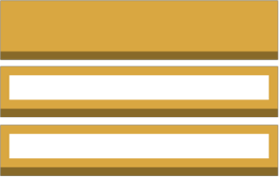

SNS + SQS: Fan Out
NOT FOR DISTRIBUTION © Stephane Maarek www.datacumulus.com
SQS Queue
Fraud Service
Buying Service
Shipping Service
SNS Topic
SQS Queue
Push once in SNS, receive in many SQS
Fully decoupled
No data loss
Ability to add receivers of data later
SQS allows for delayed processing
SQS allows for retries of work
May have many workers on one queue and one worker on the other queue
© Stephane Maarek

Slide 24

AWS Kinesis Overview
NOT FOR DISTRIBUTION © Stephane Maarek www.datacumulus.com
Kinesis is a managed alternative to Apache Kafka
Great for application logs, metrics, IoT, clickstreams
Great for “real-time” big data
Great for streaming processing frameworks (Spark, NiFi, etc…)
Data is automatically replicated to 3 AZ
Kinesis Streams: low latency streaming ingest at scale
Kinesis Analytics: perform real-time analytics on streams using SQL
Kinesis Firehose: load streams into S3, Redshift, ElasticSearch…
© Stephane Maarek

Slide 25






Kinesis
NOT FOR DISTRIBUTION © Stephane Maarek www.datacumulus.com
Amazon Kinesis
Click
Streams
Amazon S3 bucket
IoT
devices
Amazon Kinesis Streams
Amazon Kinesis Analytics
Amazon Kinesis Firehose
Metrics
& Logs
Amazon Redshift
© Stephane Maarek

Slide 26
Kinesis Streams Overview
NOT FOR DISTRIBUTION © Stephane Maarek www.datacumulus.com
Streams are divided in ordered Shards / Partitions
Shard 1
Shard 2
Shard 3
producers
consumers
Data retention is 1 day by default, can go up to 7 days
Ability to reprocess / replay data
Multiple applications can consume the same stream
Real-time processing with scale of throughput
Once data is inserted in Kinesis, it can’t be deleted (immutability)
© Stephane Maarek

Slide 27
Kinesis Streams Shards
NOT FOR DISTRIBUTION © Stephane Maarek www.datacumulus.com
One stream is made of many different shards
1MB/s or 1000 messages/s at write PER SHARD
2MB/s at read PER SHARD
Billing is per shard provisioned, can have as many shards as you want
Batching available or per message calls.
The number of shards can evolve over time (reshard / merge)
Records are ordered per shard
 | Shard 1
Shard 1 |  | Shard 1
 | Shard 2
 |  |  | Shard 1
Shard 2 |  | Shard 2
 | Shard 3
 |  |  | Shard 2
Shard 3 |  | Shard 3
 | Shard 4
producers
consumers
© Stephane Maarek

Slide 28
AWS Kinesis API – Put records
NOT FOR DISTRIBUTION © Stephane Maarek www.datacumulus.com
PutRecord API + Partition key that gets hashed
The same key goes to the same partition (helps with ordering for a specific key)
Messages sent get a “sequence number”
Key is hashed to determine shard id
Choose a partition key that is highly distributed (helps prevent “hot partition”)
Message Key
Shard 1
Shard 2
Shard 3
Shard 4
user_id if many users
Not country_id if 90% of the users are in one country
Data
produced
Use Batching with PutRecords to reduce costs and increase throughput
ProvisionedThroughputExceeded if we go over the limits
Can use CLI, AWS SDK, or producer libraries from various frameworks
© Stephane Maarek

Slide 29
AWS Kinesis API – Exceptions
NOT FOR DISTRIBUTION © Stephane Maarek www.datacumulus.com
ProvisionedThroughputExceeded Exceptions
Happens when sending more data (exceeding MB/s or TPS for any shard)
Make sure you don’t have a hot shard (such as your partition key is bad and too much data goes to that partition)
Solution:
Retries with backoff
Increase shards (scaling)
Ensure your partition key is a good one
© Stephane Maarek

Slide 30




AWS Kinesis API – Consumers
NOT FOR DISTRIBUTION © Stephane Maarek www.datacumulus.com
Can use a normal consumer (CLI, SDK, etc…)
Can use Kinesis Client Library (in Java, Node, Python, Ruby, .Net)
KCL uses DynamoDB to checkpoint offsets
KCL uses DynamoDB to track other workers and share the work amongst shards
Consume messages
Amazon Kinesis– enabled app
Checkpoint progress
Consume messages
Amazon Kinesis– enabled app
Amazon DynamoDB
© Stephane Maarek

Slide 31
Kinesis Security
NOT FOR DISTRIBUTION © Stephane Maarek www.datacumulus.com
Control access / authorization using IAM policies
Encryption in flight using HTTPS endpoints
Encryption at rest using KMS
Possibility to encrypt / decrypt data client side (harder)
VPC Endpoints available for Kinesis to access within VPC
© Stephane Maarek

Slide 32

AWS Kinesis Data Analytics
NOT FOR DISTRIBUTION © Stephane Maarek www.datacumulus.com
Perform real-time analytics on Kinesis Streams using SQL
Kinesis Data Analytics:
Auto Scaling
Managed: no servers to provision
Continuous: real time
Pay for actual consumption rate
Can create streams out of the real-time queries
© Stephane Maarek

Slide 33

AWS Kinesis Firehose
NOT FOR DISTRIBUTION © Stephane Maarek www.datacumulus.com
Fully Managed Service, no administration
Near Real Time (60 seconds latency)
Load data into Redshift / Amazon S3 / ElasticSearch / Splunk
Automatic scaling
Support many data format (pay for conversion)
Pay for the amount of data going through Firehose
© Stephane Maarek

Slide 34



SQS vs SNS vs Kinesis
NOT FOR DISTRIBUTION © Stephane Maarek www.datacumulus.com
SQS:
Consumer “pull data”
Data is deleted after being consumed
Can have as many workers (consumers) as we want
No need to provision throughput
No ordering guarantee (except FIFO queues)
Individual message delay capability
SNS:
Push data to many subscribers
Up to 10,000,000
subscribers
Data is not persisted (lost if not delivered)
Pub/Sub
Up to 100,000 topics
No need to provision throughput
Integrates with SQS for fan- out architecture pattern
Kinesis:
Consumers “pull data”
As many consumers as we want
Possibility to replay data
Meant for real-time big data, analytics and ETL
Ordering at the shard level
Data expires after X days
Must provision throughput
© Stephane Maarek

Slide 35
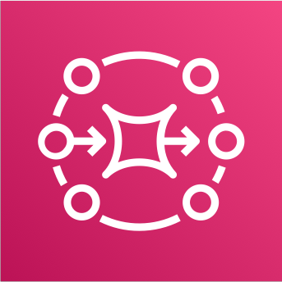
Amazon MQ
NOT FOR DISTRIBUTION © Stephane Maarek www.datacumulus.com
SQS, SNS are “cloud-native” services, and they’re using proprietary protocols from AWS.
Traditional applications running from on-premise may use open protocols such as: MQTT, AMQP, STOMP, Openwire, WSS
When migrating to the cloud, instead of re-engineering the application to use SQS and SNS, we can use Amazon MQ
Amazon MQ = managed Apache ActiveMQ
Amazon MQ doesn’t “scale” as much as SQS / SNS
Amazon MQ runs on a dedicated machine, can run in HA with failover
Amazon MQ has both queue feature (~SQS) and topic features (~SNS)
© Stephane Maarek

Slide 36
Serverless Overview
NOT FOR DISTRIBUTION © Stephane Maarek www.datacumulus.com
© Stephane Maarek

Slide 37
What’s serverless?
NOT FOR DISTRIBUTION © Stephane Maarek www.datacumulus.com
Serverless is a new paradigm in which the developers don’t have to manage servers anymore…
They just deploy code
They just deploy… functions !
Initially... Serverless == FaaS (Function as a Service)
Serverless was pioneered by AWS Lambda but now also includes anything that’s managed:“databases, messaging, storage, etc.”
Serverless does not mean there are no servers…
it means you just don’t manage / provision / see them
© Stephane Maarek

Slide 38




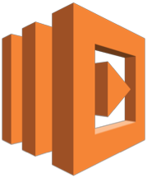

Serverless in AWS
NOT FOR DISTRIBUTION © Stephane Maarek www.datacumulus.com
AWS Lambda & Step Functions
DynamoDB
AWS Cognito
AWS API Gateway
Amazon S3
AWS SNS & SQS
AWS Kinesis
Aurora Serverless
users
REST API
Log in
Static content
Amazon S3 bucket
Amazon API Gateway
Amazon Cognito
AWS
Lambda
Amazon DynamoDB
© Stephane Maarek

Slide 39
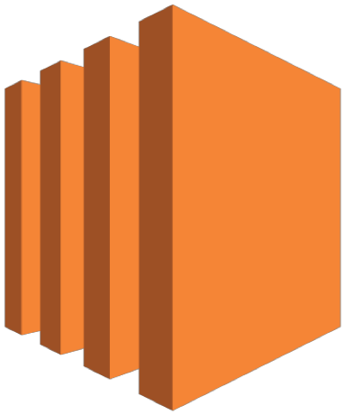
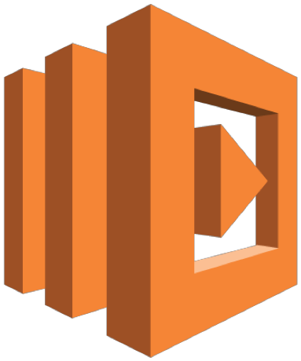
Why AWS Lambda
NOT FOR DISTRIBUTION © Stephane Maarek www.datacumulus.com
Virtual Servers in the Cloud
Limited by RAM and CPU
Continuously running
Amazon EC2
Scaling means intervention to add / remove servers
Virtual functions – no servers to manage!
Limited by time - short executions
Run on-demand
Scaling is automated!
Amazon Lambda
© Stephane Maarek

Slide 40
Benefits of AWS Lambda
NOT FOR DISTRIBUTION © Stephane Maarek www.datacumulus.com
Easy Pricing:
Pay per request and compute time
Free tier of 1,000,000 AWS Lambda requests and 400,000 GBs of compute time
Integrated with the whole AWS Stack
Integrated with many programming languages
Easy monitoring through AWS CloudWatch
Easy to get more resources per functions (up to 3GB of RAM!)
Increasing RAM will also improve CPU and network!
© Stephane Maarek

Slide 41
AWS Lambda language support
NOT FOR DISTRIBUTION © Stephane Maarek www.datacumulus.com
Node.js (JavaScript)
Python
Java (Java 8 compatible)
C# (.NET Core)
Golang
C# / Powershell
© Stephane Maarek

Slide 42




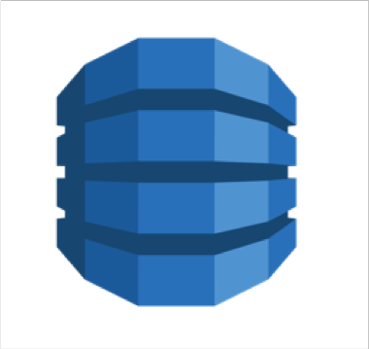





AWS Lambda Integrations Main ones
NOT FOR DISTRIBUTION © Stephane Maarek www.datacumulus.com
API Gateway
Kinesis
DynamoDB
AWS S3 –
Simple Storage Service
AWS IoT
Internet of Things
Amazon SQS
CloudWatch Events
CloudWatch Logs
AWS SNS
AWS Cognito
© Stephane Maarek

Slide 43


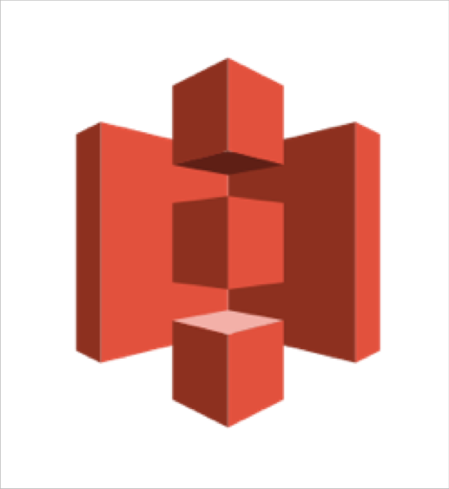
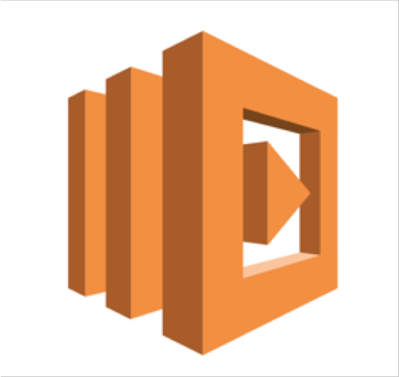
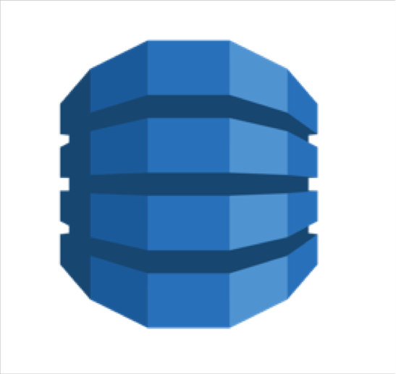

Example: Serverless Thumbnail creation
NOT FOR DISTRIBUTION © Stephane Maarek www.datacumulus.com
push
New thumbnail in S3
trigger
push
Image name Image size Creation date etc…
New image in S3
AWS Lambda Function Creates a Thumbnail
Metadata in DynamoDB
© Stephane Maarek

Slide 44
AWS Lambda Pricing
(as of June 2018, us-east-1 region)
NOT FOR DISTRIBUTION © Stephane Maarek www.datacumulus.com
You can find overall pricing information here: https://aws.amazon.com/lambda/pricing/
Pay per calls:
First 1,000,000 requests are free
$0.20 per 1 million requests thereafter ($0.0000002 per request)
Pay per duration: (in increment of 100ms)
400,000 GB-seconds of compute time per month if FREE
• == 400,000 seconds if function is 1GB RAM
• == 3,200,000 seconds if function is 128 MB RAM
After that $1.00 for 600,000 GB-seconds
It is usually very cheap to run AWS Lambda so it’s very popular
© Stephane Maarek

Slide 45
AWS Lambda Configuration
NOT FOR DISTRIBUTION © Stephane Maarek www.datacumulus.com
Timeout: default 3 seconds, max of 300s (Note: new limit 15 minutes)
Environment variables
Allocated memory (128M to 3G)
Ability to deploy within a VPC + assign security groups
IAM execution role must be attached to the Lambda function
© Stephane Maarek

Slide 46
AWS Lambda Limits to Know
NOT FOR DISTRIBUTION © Stephane Maarek www.datacumulus.com
Execution:
Memory allocation: 128 MB – 3008 MB (64 MB increments)
Maximum execution time: 300 seconds (5 minutes), now 15 minutes but 5 for exam
Disk capacity in the “function container” (in /tmp): 512 MB
Concurrency limits: 1000
Deployment:
Lambda function deployment size (compressed .zip): 50 MB
Size of uncompressed deployment (code + dependencies): 250 MB
Can use the /tmp directory to load other files at startup
Size of environment variables: 4 KB
© Stephane Maarek

Slide 47

DynamoDB
NOT FOR DISTRIBUTION © Stephane Maarek www.datacumulus.com
Fully Managed, Highly available with replication across 3 AZ
NoSQL database - not a relational database
Scales to massive workloads, distributed database
Millions of requests per seconds, trillions of row, 100s of TB of storage
Fast and consistent in performance (low latency on retrieval)
Integrated with IAM for security, authorization and administration
Enables event driven programming with DynamoDB Streams
Low cost and auto scaling capabilities
© Stephane Maarek

Slide 48
DynamoDB - Basics
NOT FOR DISTRIBUTION © Stephane Maarek www.datacumulus.com
DynamoDB is made of tables
Each table has a primary key (must be decided at creation time)
Each table can have an infinite number of items (= rows)
Each item has attributes (can be added over time – can be null)
Maximum size of a item is 400KB
Data types supported are:
Scalar Types: String, Number, Binary, Boolean, Null
Document Types: List, Map
Set Types: String Set, Number Set, Binary Set
© Stephane Maarek

Slide 49
DynamoDB – Provisioned Throughput
NOT FOR DISTRIBUTION © Stephane Maarek www.datacumulus.com
Table must have provisioned read and write capacity units
Read Capacity Units (RCU): throughput for reads ($0.00013 per RCU)
1 RCU = 1 strongly consistent read of 4 KB per second
1 RCU = 2 eventually consistent read of 4 KB per second
Write Capacity Units (WCU): throughput for writes ($0.00065 per WCU)
1 WCU = 1 write of 1 KB per second
Option to setup auto-scaling of throughput to meet demand
Throughput can be exceeded temporarily using “burst credit”
If burst credit are empty, you’ll get a “ProvisionedThroughputException”.
It’s then advised to do an exponential back-off retry
© Stephane Maarek

Slide 50






DynamoDB - DAX
NOT FOR DISTRIBUTION © Stephane Maarek www.datacumulus.com
DAX = DynamoDB Accelerator
Seamless cache for DynamoDB, no application re- write
Writes go through DAX to DynamoDB
Micro second latency for cached reads & queries
Solves the Hot Key problem (too many reads)
5 minutes TTL for cache by default
Up to 10 nodes in the cluster
Multi AZ (3 nodes minimum recommended for production)
Secure (Encryption at rest with KMS,VPC, IAM, CloudTrail…)
applications
Amazon DynamoDB Accelerator
Amazon DynamoDB
table
table
table
© Stephane Maarek

Slide 51


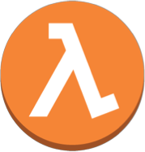
DynamoDB Streams
NOT FOR DISTRIBUTION © Stephane Maarek www.datacumulus.com
Create Update Delete
Changes in DynamoDB (Create, Update, Delete) can end up in a DynamoDB Stream
This stream can be read by AWS Lambda, and we can then do:
React to changes in real time (welcome email to new users)
Analytics
Create derivative tables / views
Insert into ElasticSearch
Could implement cross region replication using Streams
Stream has 24 hours of data retention
Amazon DynamoDB
table
changelog
Stream
Lambda function
© Stephane Maarek

Slide 52
DynamoDB - New Features
NOT FOR DISTRIBUTION © Stephane Maarek www.datacumulus.com
Transactions (new from Nov 2018)
All or nothing type of operations
Coordinated Insert, Update & Delete across multiple tables
Include up to 10 unique items or up to 4 MB of data
On Demand (new from Nov 2018)
No capacity planning needed (WCU / RCU) – scales automatically
2.5x more expensive than provisioned capacity (use with care)
Helpful when spikes are un-predictable or the application is very low throughput
© Stephane Maarek

Slide 53
DynamoDB – Security & Other Features
NOT FOR DISTRIBUTION © Stephane Maarek www.datacumulus.com
Security:
VPC Endpoints available to access DynamoDB without internet
Access fully controlled by IAM
Encryption at rest using KMS
Encryption in transit using SSL / TLS
Backup and Restore feature available
Point in time restore like RDS
No performance impact
Global Tables
Multi region, fully replicated, high performance
Amazon DMS can be used to migrate to DynamoDB (from Mongo, Oracle, MySQL, S3, etc…)
You can launch a local DynamoDB on your computer for development purposes
© Stephane Maarek

Slide 54


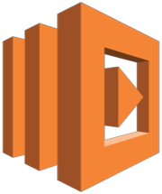

Building a Serverless API
NOT FOR DISTRIBUTION © Stephane Maarek www.datacumulus.com
REST API
PROXY REQUESTS
CRUD
Amazon API Gateway
AWS
Lambda
Amazon DynamoDB
client
© Stephane Maarek

Slide 55

AWS API Gateway
NOT FOR DISTRIBUTION © Stephane Maarek www.datacumulus.com
AWS Lambda + API Gateway: No infrastructure to manage
Handle API versioning (v1, v2…)
Handle different environments (dev, test, prod…)
Handle security (Authentication and Authorization)
Create API keys, handle request throttling
Swagger / Open API import to quickly define APIs
Transform and validate requests and responses
Generate SDK and API specifications
Cache API responses
© Stephane Maarek

Slide 56
API Gateway Integrations
NOT FOR DISTRIBUTION © Stephane Maarek www.datacumulus.com
Outside of VPC:
AWS Lambda (most popular / powerful)
Endpoints on EC2
Load Balancers
Any AWS Service
External and publicly accessible HTTP endpoints
Inside of VPC:
AWS Lambda in your VPC
EC2 endpoints in your VPC
© Stephane Maarek

Slide 57




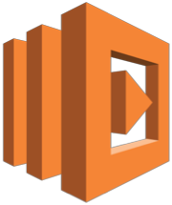
API Gateway – Security
NOT FOR DISTRIBUTION © Stephane Maarek www.datacumulus.com
IAM Permissions
Create an IAM policy authorization and attach to User / Role
API Gateway verifies IAM permissions passed by the calling application
Good to provide access within your own infrastructure
Leverages “Sig v4” capability where IAM credential are in headers
IAM
IAM Policy check
REST API w/ Sig v4
Amazon API Gateway
backend
© Stephane Maarek

Slide 58


API Gateway – Security
Lambda Authorizer (formerly Custom Authorizers)
NOT FOR DISTRIBUTION © Stephane Maarek www.datacumulus.com
Uses AWS Lambda to validate the token in header being passed
Option to cache result of authentication
Helps to use OAuth / SAML / 3rd party type of authentication
Lambda must return an IAM policy for the user
Lambda Authorizer
Evaluate Request Token Return IAM Policy
REST API
w/ Token
Amazon API Gateway
backend
© Stephane Maarek

Slide 59



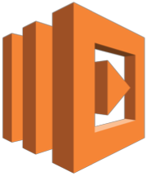
API Gateway – Security
NOT FOR DISTRIBUTION © Stephane Maarek www.datacumulus.com
Cognito User Pools
Cognito fully manages user lifecycle
API gateway verifies identity automatically from AWS Cognito
No custom implementation required
Cognito only helps with authentication, not authorization
Cognito User Pools
Authenticate Retrieve token
Evaluate Cognito Token
REST API + Pass Token
Amazon API Gateway
backend
© Stephane Maarek

Slide 60
API Gateway – Security – Summary
NOT FOR DISTRIBUTION © Stephane Maarek www.datacumulus.com
IAM:
Great for users / roles already within your AWS account
Handle authentication + authorization
Leverages Sig v4
Custom Authorizer:
Great for 3rd party tokens
Very flexible in terms of what IAM policy is returned
Handle Authentication + Authorization
Pay per Lambda invocation
Cognito User Pool:
You manage your own user pool (can be backed by Facebook, Google login etc…)
No need to write any custom code
Must implement authorization in the backend
© Stephane Maarek

Slide 61

AWS Cognito
NOT FOR DISTRIBUTION © Stephane Maarek www.datacumulus.com
We want to give our users an identity so that they can interact with our application.
Cognito User Pools:
Sign in functionality for app users
Integrate with API Gateway
Cognito Identity Pools (Federated Identity):
Provide AWS credentials to users so they can access AWS resources directly
Integrate with Cognito User Pools as an identity provider
Cognito Sync:
Synchronize data from device to Cognito.
May be deprecated and replaced by AppSync
© Stephane Maarek

Slide 62


AWS Cognito User Pools (CUP)
NOT FOR DISTRIBUTION © Stephane Maarek www.datacumulus.com
Create a serverless database of user for your mobile apps
Simple login: Username (or email) / password combination
Possibility to verify emails / phone numbers and add MFA
Can enable Federated Identities (Facebook, Google, SAML…)
Sends back a JSON Web Tokens (JWT)
Can be integrated with API Gateway for authentication
Register / Login
Send back JWT
App
CUP
© Stephane Maarek

Slide 63








AWS Cognito – Federated Identity Pools
NOT FOR DISTRIBUTION © Stephane Maarek www.datacumulus.com
Goal:
Provide direct access to AWS Resources from the Client Side
How:
Log in to federated identity provider – or remain anonymous
Get temporary AWS credentials back from the Federated Identity Pool
These credentials come with a pre-defined IAM policy stating their permissions
Example:
provide (temporary) access to write to S3 bucket using Facebook Login
Identity Provider
Twitter SAML
OpenID
….
CUP Google
Facebook
login
token
verify token
Authenticate to FIP
App
call
temp AWS credentials
Federated Identity
Get credentials
Amazon S3 bucket
© Stephane Maarek

Slide 64
AWS Cognito Sync
NOT FOR DISTRIBUTION © Stephane Maarek www.datacumulus.com
Deprecated – use AWS AppSync now
Store preferences, configuration, state of app
Cross device synchronization (any platform – iOS, Android, etc…)
Offline capability (synchronization when back online)
Requires Federated Identity Pool in Cognito (not User Pool)
Store data in datasets (up to 1MB)
Up to 20 datasets to synchronise
© Stephane Maarek

Slide 65
Serverless Architectures
NOT FOR DISTRIBUTION © Stephane Maarek www.datacumulus.com
© Stephane Maarek

Slide 66
Mobile application: MyTodoList
NOT FOR DISTRIBUTION © Stephane Maarek www.datacumulus.com
We want to create a mobile application with the following requirements
Expose as REST API with HTTPS
Serverless architecture
Users should be able to directly interact with their own folder in S3
Users should authenticate through a managed serverless service
The users can write and read to-dos, but they mostly read them
The database should scale, and have some high read throughput
© Stephane Maarek

Slide 67


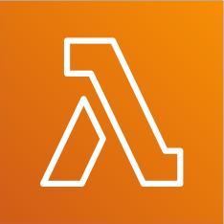
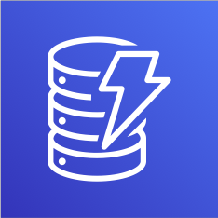

Mobile app: REST API layer
NOT FOR DISTRIBUTION © Stephane Maarek www.datacumulus.com
REST HTTPS
invoke
query
Amazon API Gateway
AWS Lambda
Amazon DynamoDB
Mobile client
Verify authentication
authenticate
Amazon Cognito
© Stephane Maarek

Slide 68



Mobile app: giving users access to S3
NOT FOR DISTRIBUTION © Stephane Maarek www.datacumulus.com
Store/retrieve files
Amazon S3
Permissions
Amazon API Gateway
AWS Lambda
Amazon DynamoDB
Mobile client
authenticate
Generate temp credentials
Amazon Cognito
AWS STS
© Stephane Maarek

Slide 69
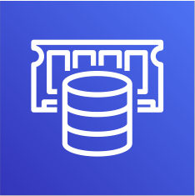
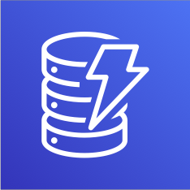
Mobile app: high read throughput, static data
NOT FOR DISTRIBUTION © Stephane Maarek www.datacumulus.com
Store/retrieve files
Amazon S3
Permissions
REST HTTPS
invoke
Query / read
Amazon API Gateway
AWS Lambda
DAX
Caching layer
DynamoDB
Mobile client
Verify authentication
authenticate
Generate temp credentials
Amazon Cognito
AWS STS
© Stephane Maarek

Slide 70
Mobile app: caching at the API Gateway
NOT FOR DISTRIBUTION © Stephane Maarek www.datacumulus.com
Store/retrieve files
Amazon S3
CACHING OF RESPONSES
Permissions
REST HTTPS
invoke
Query / read
Amazon API Gateway
AWS Lambda
DAX
Caching layer
DynamoDB
Mobile client
Verify authentication
authenticate
Generate temp credentials
Amazon Cognito
AWS STS
© Stephane Maarek

Slide 71
In this lecture
NOT FOR DISTRIBUTION © Stephane Maarek www.datacumulus.com
Serverless REST API: HTTPS, API Gateway, Lambda, DynamoDB
Using Cognito to generate temporary credentials with STS to access S3 bucket with restricted policy. App users can directly access AWS resources this way. Pattern can be applied to DynamoDB, Lambda…
Caching the reads on DynamoDB using DAX
Caching the REST requests at the API Gateway level
Security for authentication and authorization with Cognito, STS
© Stephane Maarek

Slide 72
Serverless hosted website: MyBlog.com
NOT FOR DISTRIBUTION © Stephane Maarek www.datacumulus.com
This website should scale globally
Blogs are rarely written, but often read
Some of the website is purely static files, the rest is a dynamic REST API
Caching must be implement where possible
Any new users that subscribes should receive a welcome email
Any photo uploaded to the blog should have a thumbnail generated
© Stephane Maarek

Slide 73



Serving static content, globally
NOT FOR DISTRIBUTION © Stephane Maarek www.datacumulus.com
Interaction with edge locations
Amazon CloudFront Global distribution
Amazon S3
Client
© Stephane Maarek

Slide 74


Serving static content, globally, securely
NOT FOR DISTRIBUTION © Stephane Maarek www.datacumulus.com
OAI: Origin Access Identity
Interaction with
Bucket policy
Only authorize from OAI
edge locations
Amazon CloudFront Global distribution
Amazon S3
Client
© Stephane Maarek

Slide 75
Adding a public serverless REST API
NOT FOR DISTRIBUTION © Stephane Maarek www.datacumulus.com
OAI: Origin Access Identity
Interaction with
Bucket policy
Only authorize from OAI
edge locations
Amazon CloudFront Global distribution
Amazon S3
REST HTTPS
invoke
Query / read
Amazon API Gateway
AWS Lambda
DAX
Caching layer
DynamoDB
Client
© Stephane Maarek

Slide 76
Leveraging DynamoDB Global Tables
NOT FOR DISTRIBUTION © Stephane Maarek www.datacumulus.com
OAI: Origin Access Identity
Interaction with
Bucket policy
Only authorize from OAI
edge locations
Amazon CloudFront Global distribution
Amazon S3
REST HTTPS
invoke
Query / read
Amazon API Gateway
AWS Lambda
DAX
Caching layer
DynamoDB
Global Tables
Client
© Stephane Maarek

Slide 77


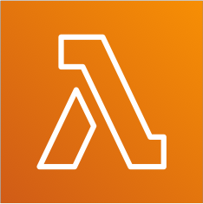
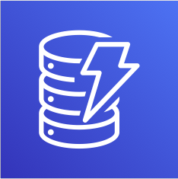
User Welcome email flow
NOT FOR DISTRIBUTION © Stephane Maarek www.datacumulus.com
OAI: Origin Access Identity
Interaction with
Bucket policy
Only authorize from OAI
edge locations
Amazon CloudFront Global distribution
Amazon S3
REST HTTPS
invoke
Query / read
Amazon API Gateway
AWS Lambda
DAX
Caching layer
DynamoDB
Client
Stream changes
IAM Role
SDK to send email
Invoke lambda
Amazon Simple Email Service (SES)
AWS Lambda
DynamoDB
Stream
© Stephane Maarek

Slide 78



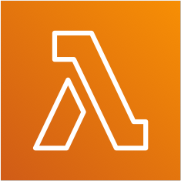


Thumbnail Generation flow
NOT FOR DISTRIBUTION © Stephane Maarek www.datacumulus.com
OAI: Origin Access Identity
Interaction with
Bucket policy
Only authorize from OAI
edge locations
Amazon CloudFront Global distribution
Amazon S3
REST HTTPS
invoke
Query / read
Amazon API Gateway
AWS Lambda
DAX
Caching layer
optional
DynamoDB
Client
Upload photos Transfer acceleration
OAI
trigger
thumbnail
SQS
Amazon CloudFront Global distribution
Amazon S3
AWS Lambda
Amazon S3
SNS
© Stephane Maarek

Slide 79
AWS Hosted Website Summary
NOT FOR DISTRIBUTION © Stephane Maarek www.datacumulus.com
We’ve seen static content being distributed using CloudFront with S3
The REST API was serverless, didn’t need Cognito because public
We leveraged a Global DynamoDB table to serve the data globally
(we could have used Aurora Global Tables)
We enabled DynamoDB streams to trigger a Lambda function
The lambda function had an IAM role which could use SES
SES (Simple Email Service) was used to send emails in a serverless way
S3 can trigger SQS / SNS / Lambda to notify of events
© Stephane Maarek

Slide 80
Micro Services architecture
NOT FOR DISTRIBUTION © Stephane Maarek www.datacumulus.com
We want to switch to a micro service architecture
Many services interact with each other directly using a REST API
Each architecture for each micro service may vary in form and shape
We want a micro-service architecture so we can have a leaner development lifecycle for each service
© Stephane Maarek

Slide 81



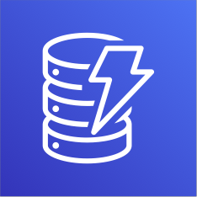


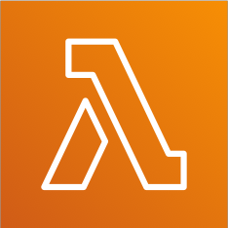
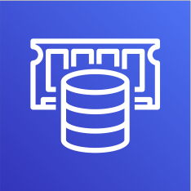


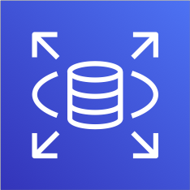
Micro Services Environment
NOT FOR DISTRIBUTION © Stephane Maarek www.datacumulus.com
service1.example.com
DNS Query
Amazon Route 53
Elastic Load Balancing
ECS
DynamoDB
service2.example.com
HTTPS
Amazon API Gateway
AWS Lambda
ElastiCache
service3.example.com
Users
Elastic Load Balancing
Amazon EC2 Auto Scaling
Amazon RDS
© Stephane Maarek

Slide 82
Discussions on Micro Services
NOT FOR DISTRIBUTION © Stephane Maarek www.datacumulus.com
You are free to design each micro-service the way you want
Synchronous patterns: API Gateway, Load Balancers
Asynchronous patterns: SQS, Kinesis, SNS, Lambda triggers (S3)
Challenges with micro-services:
repeated overhead for creating each new microservice,
issues with optimizing server density/utilization
complexity of running multiple versions of multiple microservices simultaneously
proliferation of client-side code requirements to integrate with many separate services.
Some of the challenges are solved by Serverless patterns:
API Gateway, Lambda scale automatically and you pay per usage
You can easily clone API, reproduce environments
Generated client SDK through Swagger integration for the API Gateway
© Stephane Maarek

Slide 83
Distributing paid content
NOT FOR DISTRIBUTION © Stephane Maarek www.datacumulus.com
We sell videos online and users have to paid to buy videos
Each videos can be bought by many different customers
We only want to distribute videos to users who are premium users
We have a database of premium users
Links we send to premium users should be short lived
Our application is global
We want to be fully serverless
© Stephane Maarek

Slide 84

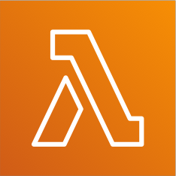

Start simple, premium user service
NOT FOR DISTRIBUTION © Stephane Maarek www.datacumulus.com
Client
REST HTTPS
invoke
Query / read
Tables of users
And who is premium
Amazon API Gateway
AWS Lambda
DynamoDB
© Stephane Maarek

Slide 85

Add authentication
NOT FOR DISTRIBUTION © Stephane Maarek www.datacumulus.com
authenticate
Amazon Cognito
Verify authentication
Client
REST HTTPS
invoke
Query / read
Amazon API Gateway
AWS Lambda
DynamoDB
© Stephane Maarek

Slide 86

Add Videos Storage Service
NOT FOR DISTRIBUTION © Stephane Maarek www.datacumulus.com
Amazon S3
authenticate
Amazon Cognito
Verify authentication
Client
REST HTTPS
invoke
Query / read
Amazon API Gateway
AWS Lambda
DynamoDB
© Stephane Maarek

Slide 87
Distribute Globally and Secure
NOT FOR DISTRIBUTION © Stephane Maarek www.datacumulus.com
OAI: Origin Access Identity
Bucket policy
Only authorize from OAI
Amazon CloudFront Global distribution
Amazon S3
authenticate
Amazon Cognito
Verify authentication
Client
REST HTTPS
invoke
Query / read
Amazon API Gateway
AWS Lambda
DynamoDB
© Stephane Maarek

Slide 88






Distribute Content only to premium users
NOT FOR DISTRIBUTION © Stephane Maarek www.datacumulus.com
OAI: Origin Access Identity
Bucket policy
Only authorize from OAI
Use Signed URL
Generate CloudFront Signed URL using AWS SDK expiration 5 minutes
Amazon CloudFront Global distribution
Amazon S3
Query for URL
Signed URL
Amazon API Gateway
Verify auth
invoke
Verify premium user
AWS Lambda
Client
invoke
Query / read
authenticate
Amazon API Gateway
AWS Lambda
DynamoDB
Amazon Cognito
© Stephane Maarek

Slide 89
Premium User Video service
NOT FOR DISTRIBUTION © Stephane Maarek www.datacumulus.com
We have implemented a fully serverless solution:
Cognito for authentication
DynamoDB for storing users that are premium
2 serverless applications
Premium User registration
CloudFront Signed URL generator
Content is stored in S3 (serverless and scalable)
Integrated with CloudFront with OAI for security (users can’t bypass)
CloudFront can only be used using Signed URLs to prevent unauthorized users
What about S3 Signed URL? They’re not efficient for global access
© Stephane Maarek

Slide 90
Software updates offloading
NOT FOR DISTRIBUTION © Stephane Maarek www.datacumulus.com
We have an application running on EC2, that distributes software updates once in a while
When a new software update is out, we get a lot of request and the content is distributed in mass over the network. It’s very costly
We don’t want to change our application, but want to optimize our cost and CPU, how can we do it?
© Stephane Maarek

Slide 91





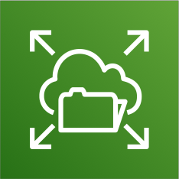



Our application current state
NOT FOR DISTRIBUTION © Stephane Maarek www.datacumulus.com
Auto Scaling group
Availability zone 1
Availability zone 1 to 3
Availability zone 2
Amazon Elastic File System
Availability zone 3
© Stephane Maarek

Slide 92

Easy way to fix things!
NOT FOR DISTRIBUTION © Stephane Maarek www.datacumulus.com
Auto Scaling group
Availability zone 1
Availability zone 1 to 3
Availability zone 2
Amazon Elastic File System
Amazon CloudFront
Availability zone 3
© Stephane Maarek

Slide 93
Why CloudFront?
NOT FOR DISTRIBUTION © Stephane Maarek www.datacumulus.com
No changes to architecture
Will cache software update files at the edge
Software update files are not dynamic, they’re static (never changing)
Our EC2 instances aren’t serverless
But CloudFront is, and will scale for us
Our ASG will not scale as much, and we’ll save tremendously in EC2
We’ll also save in availability, network bandwidth cost, etc
Easy way to make an existing application more scalable and cheaper!
© Stephane Maarek

Slide 94
Big Data Ingestion Pipeline
NOT FOR DISTRIBUTION © Stephane Maarek www.datacumulus.com
We want the ingestion pipeline to be fully serverless
We want to collect data in real time
We want to transform the data
We want to query the transformed data using SQL
The reports created using the queries should be in S3
We want to load that data into a warehouse and create dashboards
© Stephane Maarek

Slide 95





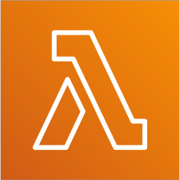


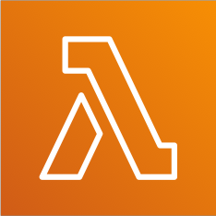

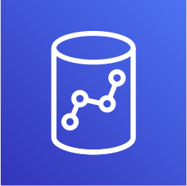
Big Data Ingestion Pipeline
NOT FOR DISTRIBUTION © Stephane Maarek www.datacumulus.com
IoT Devices
Pull data
Real-time
Ingestion Bucket
Reporting Bucket
Every 1 minute
trigger
Amazon Kinesis Data Streams
Amazon Kinesis Data Firehose
Amazon Simple Storage Amazon Simple Queue
AWS Lambda
Amazon Athena
Amazon Simple Storage Service (S3)
Service (S3)
Service
(optional)
AWS Lambda
Amazon QuickSight
Amazon Redshift (not serverless)
© Stephane Maarek

Slide 96
Big Data Ingestion Pipeline discussion
NOT FOR DISTRIBUTION © Stephane Maarek www.datacumulus.com
IoT Core allows you to harvest data from IoT devices
Kinesis is great for real-time data collection
Firehose helps with data delivery to S3 in near real-time (1 minute)
Lambda can help Firehose with data transformations
Amazon S3 can trigger notifications to SQS
Lambda can subscribe to SQS (we could have connecter S3 to Lambda)
Athena is a serverless SQL service and results are stored in S3
The reporting bucket contains analyzed data and can be used by reporting tool such as AWS QuickSight, Redshift, etc…
© Stephane Maarek

Slide 97
Databases
NOT FOR DISTRIBUTION © Stephane Maarek www.datacumulus.com
© Stephane Maarek

Slide 98
Choosing the Right Database
NOT FOR DISTRIBUTION © Stephane Maarek www.datacumulus.com
We have a lot of managed databases on AWS to choose from
Questions to choose the right database based on your architecture:
Read-heavy, write-heavy, or balanced workload? Throughput needs? Will it change, does it need to scale or fluctuate during the day?
How much data to store and for how long? Will it grow? Average object size? How are they accessed?
Data durability? Source of truth for the data ?
Latency requirements? Concurrent users?
Data model? How will you query the data? Joins? Structured? Semi-Structured?
Strong schema? More flexibility? Reporting? Search? RBDMS / NoSQL?
License costs? Switch to Cloud Native DB such as Aurora?
© Stephane Maarek

Slide 99
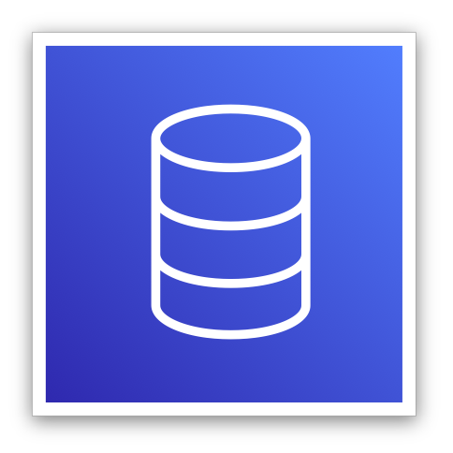
Database Types
NOT FOR DISTRIBUTION © Stephane Maarek www.datacumulus.com
RDBMS (= SQL / OLTP): RDS, Aurora – great for joins
NoSQL database: DynamoDB (~JSON), ElastiCache (key / value pairs), Neptune (graphs) – no joins, no SQL
Object Store: S3 (for big objects) / Glacier (for backups / archives)
Data Warehouse (= SQL Analytics / BI): Redshift (OLAP), Athena
Search: ElasticSearch (JSON) – free text, unstructured searches
Graphs: Neptune – displays relationships between data
© Stephane Maarek

Slide 100
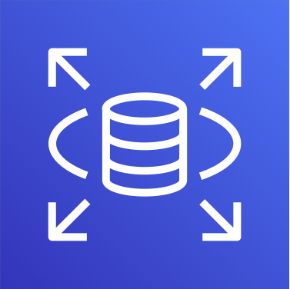
RDS Overview
NOT FOR DISTRIBUTION © Stephane Maarek www.datacumulus.com
Managed PostgreSQL / MySQL / Oracle / SQL Server
Must provision an EC2 instance & EBS Volume type and size
Support for Read Replicas and Multi AZ
Security through IAM, Security Groups, KMS , SSL in transit
Backup / Snapshot / Point in time restore feature
Managed and Scheduled maintenance
Monitoring through CloudWatch
Use case: Store relational datasets (RDBMS / OLTP), perform SQL queries, transactional inserts / update / delete is available
© Stephane Maarek

Slide 101
RDS for Solutions Architect
NOT FOR DISTRIBUTION © Stephane Maarek www.datacumulus.com
Operations: small downtime when failover happens, when maintenance happens, scaling in read replicas / ec2 instance / restore EBS implies manual intervention, application changes
Security: AWS responsible for OS security, we are responsible for setting up KMS, security groups, IAM policies, authorizing users in DB, using SSL
Reliability: Multi AZ feature, failover in case of failures
Performance: depends on EC2 instance type, EBS volume type, ability to add Read Replicas. Doesn’t auto-scale
Cost: Pay per hour based on provisioned EC2 and EBS
© Stephane Maarek

Slide 102
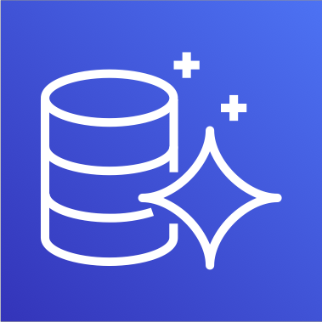
Aurora Overview
NOT FOR DISTRIBUTION © Stephane Maarek www.datacumulus.com
Compatible API for PostgreSQL / MySQL
Data is held in 6 replicas, across 3 AZ
Auto healing capability
Multi AZ, Auto Scaling Read Replicas
Read Replicas can be Global
Aurora database can be Global for DR or latency purposes
Auto scaling of storage from 10GB to 64 TB
Define EC2 instance type for aurora instances
Same security / monitoring / maintenance features as RDS
“Aurora Serverless” option
Use case: same as RDS, but with less maintenance / more flexibility / more performance
© Stephane Maarek

Slide 103
Aurora for Solutions Architect
NOT FOR DISTRIBUTION © Stephane Maarek www.datacumulus.com
Operations: less operations, auto scaling storage
Security: AWS responsible for OS security, we are responsible for setting up KMS, security groups, IAM policies, authorizing users in DB, using SSL
Reliability: Multi AZ, highly available, possibly more than RDS, Aurora Serverless option.
Performance: 5x performance (according to AWS) due to architectural optimizations. Up to 15 Read Replicas (only 5 for RDS)
Cost: Pay per hour based on EC2 and storage usage. Possibly lower costs compared to Enterprise grade databases such as Oracle
© Stephane Maarek

Slide 104
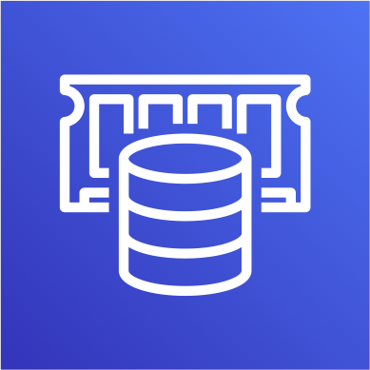
ElastiCache Overview
NOT FOR DISTRIBUTION © Stephane Maarek www.datacumulus.com
Managed Redis / Memcached (similar offering as RDS, but for caches)
In-memory data store, sub-millisecond latency
Must provision an EC2 instance type
Support for Clustering (Redis) and Multi AZ, Read Replicas (sharding)
Security through IAM, Security Groups, KMS, Redis Auth
Backup / Snapshot / Point in time restore feature
Managed and Scheduled maintenance
Monitoring through CloudWatch
Use Case: Key/Value store, Frequent reads, less writes, cache results for DB queries, store session data for websites, cannot use SQL.
© Stephane Maarek

Slide 105
ElastiCache for Solutions Architect
NOT FOR DISTRIBUTION © Stephane Maarek www.datacumulus.com
Operations: same as RDS
Security: AWS responsible for OS security, we are responsible for setting up KMS, security groups, IAM policies, users (Redis Auth), using SSL
Reliability: Clustering, Multi AZ
Performance: Sub-millisecond performance, in memory, read replicas for sharding, very popular cache option
Cost: Pay per hour based on EC2 and storage usage
© Stephane Maarek

Slide 106
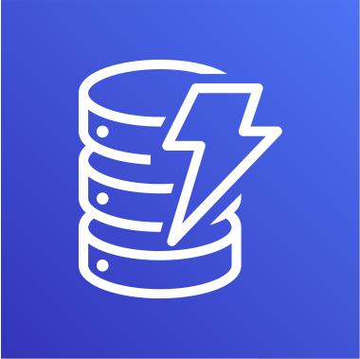
DynamoDB Overview
NOT FOR DISTRIBUTION © Stephane Maarek www.datacumulus.com
AWS proprietary technology, managed NoSQL database
Serverless, provisioned capacity, auto scaling, on demand capacity (Nov 2018)
Can replace ElastiCache as a key/value store (storing session data for example)
Highly Available, Multi AZ by default, Read and Writes are decoupled, DAX for read cache
Reads can be eventually consistent or strongly consistent
Security, authentication and authorization is done through IAM
DynamoDB Streams to integrate with AWS Lambda
Backup / Restore feature, Global Table feature
Monitoring through CloudWatch
Can only query on primary key, sort key, or indexes
Use Case: Serverless applications development (small documents 100s KB), distributed serverless cache, doesn’t have SQL query language available, has transactions capability from Nov 2018
© Stephane Maarek

Slide 107
DynamoDB for Solutions Architect
NOT FOR DISTRIBUTION © Stephane Maarek www.datacumulus.com
Operations: no operations needed, auto scaling capability, serverless
Security: full security through IAM policies, KMS encryption, SSL in flight
Reliability: Multi AZ, Backups
Performance: single digit millisecond performance, DAX for caching reads, performance doesn’t degrade if your application scales
Cost: Pay per provisioned capacity and storage usage (no need to guess in advance any capacity – can use auto scaling)
© Stephane Maarek

Slide 108

S3 Overview
NOT FOR DISTRIBUTION © Stephane Maarek www.datacumulus.com
S3 is a… key / value store for objects
Great for big objects, not so great for small objects
Serverless, scales infinitely, max object size is 5 TB
Eventually consistency for overwrites and deletes
Tiers: S3 Standard, S3 IA, S3 One Zone IA, Glacier for backups
Features:Versioning, Encryption, Cross Region Replication, etc…
Security: IAM, Bucket Policies, ACL
Encryption: SSE-S3, SSE-KMS, SSE-C, client side encryption, SSL in transit
Use Case: static files, key value store for big files, website hosting
© Stephane Maarek

Slide 109
S3 for Solutions Architect
NOT FOR DISTRIBUTION © Stephane Maarek www.datacumulus.com
Operations: no operations needed
Security: IAM, Bucket Policies, ACL, Encryption (Server/Client), SSL
Reliability: 99.999999999% durability / 99.99% availability, Multi AZ, CRR
Performance: scales to thousands of read / writes per second, transfer acceleration / multi-part for big files
Cost: pay per storage usage, network cost, requests number
© Stephane Maarek

Slide 110

Athena Overview
NOT FOR DISTRIBUTION © Stephane Maarek www.datacumulus.com
Fully Serverless database with SQL capabilities
Used to query data in S3
Pay per query
Output results back to S3
Secured through IAM
Use Case: one time SQL queries, serverless queries on S3, log analytics
© Stephane Maarek

Slide 111
Athena for Solutions Architect
NOT FOR DISTRIBUTION © Stephane Maarek www.datacumulus.com
Operations: no operations needed, serverless
Security: IAM + S3 security
Reliability: managed service, uses Presto engine, highly available
Performance: queries scale based on data size
Cost: pay per query / per TB of data scanned, serverless
© Stephane Maarek

Slide 112
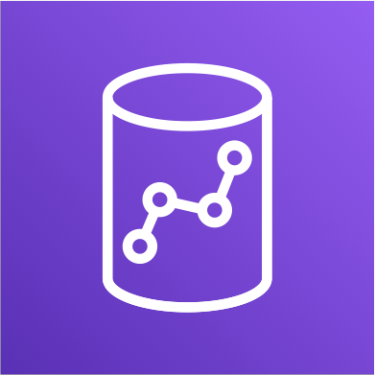
Redshift Overview
NOT FOR DISTRIBUTION © Stephane Maarek www.datacumulus.com
Redshift is based on PostgreSQL, but it’s not used for OLTP
It’s OLAP – online analytical processing (analytics and data warehousing)
10x better performance than other data warehouses, scale to PBs of data
Columnar storage of data (instead of row based)
Massively Parallel Query Execution (MPP), highly available
Pay as you go based on the instances provisioned
Has a SQL interface for performing the queries
BI tools such as AWS Quicksight or Tableau integrate with it
© Stephane Maarek

Slide 113
Redshift Continued…
NOT FOR DISTRIBUTION © Stephane Maarek www.datacumulus.com
Data is loaded from S3, DynamoDB, DMS, other DBs…
From 1 node to 128 nodes, up to 160 GB of space per node
Leader node: for query planning, results aggregation
Compute node: for performing the queries, send results to leader
Redshift Spectrum: perform queries directly against S3 (no need to load)
Backup & Restore, Security VPC / IAM / KMS, Monitoring
Redshift Enhanced VPC Routing: COPY / UNLOAD goes through VPC
© Stephane Maarek

Slide 114
Redshift for Solutions Architect
NOT FOR DISTRIBUTION © Stephane Maarek www.datacumulus.com
Operations: similar to RDS
Security: IAM,VPC, KMS, SSL (similar to RDS)
Reliability: highly available, auto healing features
Performance: 10x performance vs other data warehousing, compression
Cost: pay per node provisioned, 1/10th of the cost vs other warehouses
Remember: Redshift = Analytics / BI / Data Warehouse
© Stephane Maarek

Slide 115
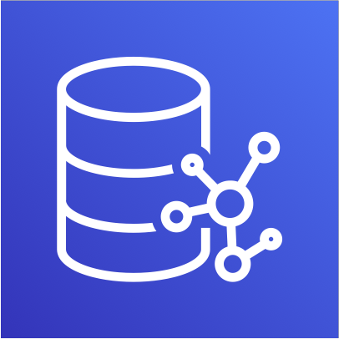
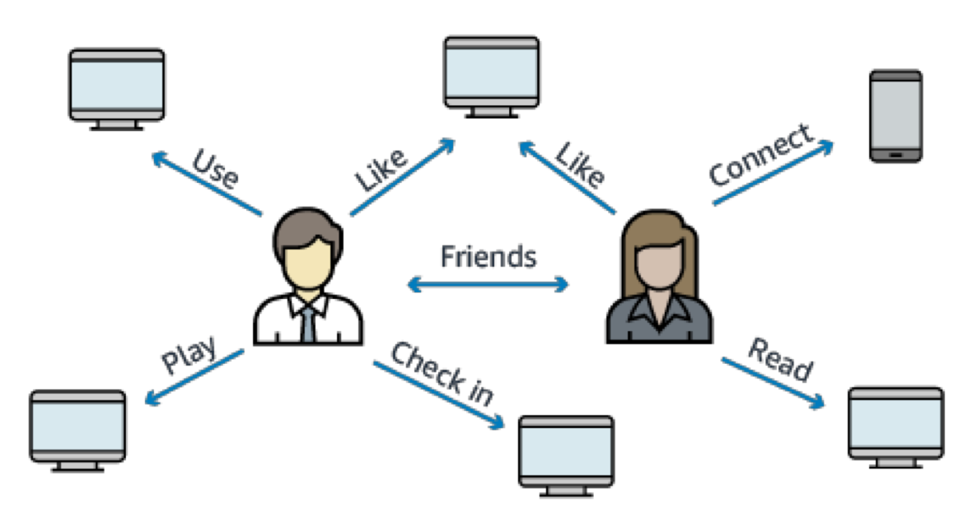
Neptune
NOT FOR DISTRIBUTION © Stephane Maarek www.datacumulus.com
Fully managed graph database
When do we use Graphs?
High relationship data
Social Networking: Users friends with Users, replied to comment on post of user and likes other comments.
Knowledge graphs (Wikipedia)
Highly available across 3 AZ, with up to 15 read replicas
Point-in-time recovery, continuous backup to Amazon S3
Support for KMS encryption at rest + HTTPS
© Stephane Maarek

Slide 116
Neptune for Solutions Architect
NOT FOR DISTRIBUTION © Stephane Maarek www.datacumulus.com
Operations: similar to RDS
Security: IAM,VPC, KMS, SSL (similar to RDS) + IAM Authentication
Reliability: Multi-AZ, clustering
Performance: best suited for graphs, clustering to improve performance
Cost: pay per node provisioned (similar to RDS)
Remember: Neptune = Graphs
© Stephane Maarek

Slide 117

ElasticSearch
NOT FOR DISTRIBUTION © Stephane Maarek www.datacumulus.com
Example: In DynamoDB, you can only find by primary key or indexes.
With ElasticSearch, you can search any field, even partially matches
It’s common to use ElasticSearch as a complement to another database
ElasticSearch also has some usage for Big Data applications
You can provision a cluster of instances
Built-in integrations: Amazon Kinesis Data Firehose, AWS IoT, and Amazon CloudWatch Logs for data ingestion
Security through Cognito & IAM, KMS encryption, SSL & VPC
Comes with Kibana (visualization) & Logstash (log ingestion) – ELK stack
© Stephane Maarek

Slide 118
ElasticSearch for Solutions Architect
NOT FOR DISTRIBUTION © Stephane Maarek www.datacumulus.com
Operations: similar to RDS
Security: Cognito, IAM,VPC, KMS, SSL
Reliability: Multi-AZ, clustering
Performance: based on ElasticSearch project (open source), petabyte scale
Cost: pay per node provisioned (similar to RDS)
Remember: ElasticSearch = Search / Indexing
© Stephane Maarek

Slide 119
AWS Monitoring, Audit and Performance
CloudWatch, CloudTrail & AWS Config
NOT FOR DISTRIBUTION © Stephane Maarek www.datacumulus.com
© Stephane Maarek

Slide 120

AWS CloudWatch Metrics
NOT FOR DISTRIBUTION © Stephane Maarek www.datacumulus.com
CloudWatch provides metrics for every services in AWS
Metric is a variable to monitor (CPUUtilization, NetworkIn…)
Metrics belong to namespaces
Dimension is an attribute of a metric (instance id, environment, etc…).
Up to 10 dimensions per metric
Metrics have timestamps
Can create CloudWatch dashboards of metrics
© Stephane Maarek

Slide 121
AWS CloudWatch EC2 Detailed monitoring
NOT FOR DISTRIBUTION © Stephane Maarek www.datacumulus.com
EC2 instance metrics have metrics “every 5 minutes”
With detailed monitoring (for a cost), you get data “every 1 minute”
Use detailed monitoring if you want to more prompt scale your ASG!
The AWS Free Tier allows us to have 10 detailed monitoring metrics
Note: EC2 Memory usage is by default not pushed (must be pushed from inside the instance as a custom metric)
© Stephane Maarek

Slide 122
AWS CloudWatch Custom Metrics
NOT FOR DISTRIBUTION © Stephane Maarek www.datacumulus.com
Possibility to define and send your own custom metrics to CloudWatch
Ability to use dimensions (attributes) to segment metrics
Instance.id
Environment.name
Metric resolution:
Standard: 1 minute
High Resolution: up to 1 second (StorageResolution API parameter) – Higher cost
Use API call PutMetricData
Use exponential back off in case of throttle errors
© Stephane Maarek

Slide 123
CloudWatch Dashboards
NOT FOR DISTRIBUTION © Stephane Maarek www.datacumulus.com
Great way to setup dashboards for quick access to keys metrics
Dashboards are global
Dashboards can include graphs from different regions
You can change the time zone & time range of the dashboards
You can setup automatic refresh (10s, 1m, 2m, 5m, 15m)
Pricing:
3 dashboards (up to 50 metrics) for free
$3/dashboard/month afterwards
© Stephane Maarek

Slide 124
AWS CloudWatch Logs
NOT FOR DISTRIBUTION © Stephane Maarek www.datacumulus.com
Applications can send logs to CloudWatch using the SDK
CloudWatch can collect log from:
Elastic Beanstalk: collection of logs from application
ECS: collection from containers
AWS Lambda: collection from function logs
VPC Flow Logs:VPC specific logs
API Gateway
CloudTrail based on filter
CloudWatch log agents: for example on EC2 machines
Route53: Log DNS queries
CloudWatch Logs can go to:
Batch exporter to S3 for archival
Stream to ElasticSearch cluster for further analytics
© Stephane Maarek

Slide 125
AWS CloudWatch Logs
NOT FOR DISTRIBUTION © Stephane Maarek www.datacumulus.com
Logs storage architecture:
Log groups: arbitrary name, usually representing an application
Log stream: instances within application / log files / containers
Can define log expiration policies (never expire, 30 days, etc..)
Using the AWS CLI we can tail CloudWatch logs
To send logs to CloudWatch, make sure IAM permissions are correct!
Security: encryption of logs using KMS at the Group Level
© Stephane Maarek

Slide 126
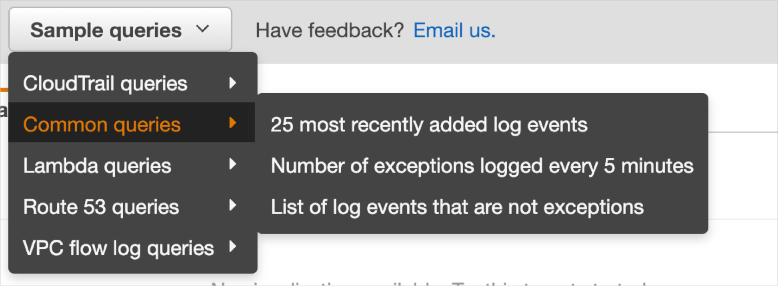
CloudWatch Logs Metric Filter & Insights
NOT FOR DISTRIBUTION © Stephane Maarek www.datacumulus.com
CloudWatch Logs can use filter expressions
For example, find a specific IP inside of a log
Metric filters can be used to trigger alarms
CloudWatch Logs Insights (new – Nov 2018) can be used to query logs and add queries to CloudWatch Dashboards
© Stephane Maarek

Slide 127

AWS CloudWatch Alarms
NOT FOR DISTRIBUTION © Stephane Maarek www.datacumulus.com
Alarms are used to trigger notifications for any metric
Alarms can go to Auto Scaling, EC2 Actions, SNS notifications
Various options (sampling, %, max, min, etc…)
Alarm States:
OK
INSUFFICIENT_DATA
ALARM
Period:
Length of time in seconds to evaluate the metric
High resolution custom metrics: can only choose 10 sec or 30 sec
© Stephane Maarek

Slide 128



AWS CloudWatch Events
NOT FOR DISTRIBUTION © Stephane Maarek www.datacumulus.com
Source + Rule => Target
Schedule: Cron jobs
Event Pattern: Event rules to react to a service doing something
Ex: CodePipeline state changes!
Triggers to Lambda functions, SQS/SNS/Kinesis Messages
CloudWatch Event creates a small JSON document to give information about the change
© Stephane Maarek

Slide 129
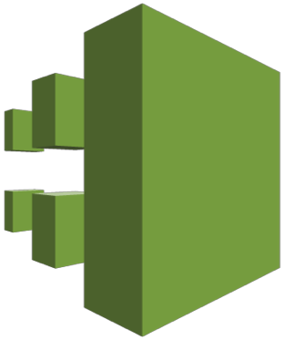
AWS CloudTrail
NOT FOR DISTRIBUTION © Stephane Maarek www.datacumulus.com
Provides governance, compliance and audit for your AWS Account
CloudTrail is enabled by default!
Get an history of events / API calls made within your AWS Account by:
Console
SDK
CLI
AWS Services
Can put logs from CloudTrail into CloudWatch Logs
If a resource is deleted in AWS, look into CloudTrail first!
© Stephane Maarek

Slide 130
NOT FOR DISTRIBUTION © Stephane Maarek www.datacumulus.com
AWS Security & Encryption
KMS, Encryption SDK, SSM Parameter Store
© Stephane Maarek

Slide 131
Why encryption?
NOT FOR DISTRIBUTION © Stephane Maarek www.datacumulus.com
Encryption in flight (SSL)
Data is encrypted before sending and decrypted after receiving
SSL certificates help with encryption (HTTPS)
Encryption in flight ensures no MITM (man in the middle attack) can happen
You
aGVsbG8gd29 ybGQgZWh…
HTTPS Website (AWS)
HTTPS
U: admin
P: supersecret
aGVsbG8gd29 ybGQgZWh…
aGVsbG8gd29 ybGQgZWh…
SSL Encryption
SSL Decryption
U: admin
P: supersecret
© Stephane Maarek

Slide 132








Why encryption?
NOT FOR DISTRIBUTION © Stephane Maarek www.datacumulus.com
Server side encryption at rest
Data is encrypted after being received by the server
Data is decrypted before being sent
It is stored in an encrypted form thanks to a key (usually a data key)
The encryption / decryption keys must be managed somewhere and
the server must have access to it
Object
AWS Service (ex: EBS)
Object
HTTP/S
HTTP/S
+
encryption
decryption
Data key
Data key
© Stephane Maarek

Slide 133










Why encryption?
NOT FOR DISTRIBUTION © Stephane
Client side encryption
Data is encrypted by the client and never decrypted by the server
Data will be decrypted by a receiving client
The server should not be able to decrypt the data
Could leverage Envelope Encryption
Object
Client Encryption
Any store (FTP,
S3, etc..)
Object
Client Decryption
M
r w
.
t
l
a a ek
+
+
encryption
decryption
ww da acumu us.com
Client side data key
Client side data key
© Stephane Maarek

Slide 134

AWS KMS (Key Management Service)
NOT FOR DISTRIBUTION © Stephane Maarek www.datacumulus.com
Anytime you hear “encryption” for an AWS service, it’s most likely KMS
Easy way to control access to your data, AWS manages keys for us
Fully integrated with IAM for authorization
Seamlessly integrated into:
Amazon EBS: encrypt volumes
Amazon S3: Server side encryption of objects
Amazon Redshift: encryption of data
Amazon RDS: encryption of data
Amazon SSM: Parameter store
Etc…
But you can also use the CLI / SDK
© Stephane Maarek

Slide 135
AWS KMS 101
NOT FOR DISTRIBUTION © Stephane Maarek www.datacumulus.com
Anytime you need to share sensitive information… use KMS
Database passwords
Credentials to external service
Private Key of SSL certificates
The value in KMS is that the CMK used to encrypt data can never be retrieved by the user, and the CMK can be rotated for extra security
Never ever store your secrets in plaintext, especially in your code!
Encrypted secrets can be stored in the code / environment variables
KMS can only help in encrypting up to 4KB of data per call
If data > 4 KB, use envelope encryption
To give access to KMS to someone:
Make sure the Key Policy allows the user
Make sure the IAM Policy allows the API calls
© Stephane Maarek

Slide 136
AWS KMS (Key Management Service)
NOT FOR DISTRIBUTION © Stephane Maarek www.datacumulus.com
Able to fully manage the keys & policies:
Create
Rotation policies
Disable
Enable
Able to audit key usage (using CloudTrail)
Three types of Customer Master Keys (CMK):
AWS Managed Service Default CMK: free
User Keys created in KMS: $1 / month
User Keys imported (must be 256-bit symmetric key): $1 / month
• + pay for API call to KMS ($0.03 / 10000 calls)
© Stephane Maarek

Slide 137






How does KMS work?
API – Encrypt and Decrypt
NOT FOR DISTRIBUTION © Stephane Maarek www.datacumulus.com
Client (CLI / SDK) Encrypt API
KMS
CMK
Perform encryption
CMK
Perform decryption
Check IAM permissions
IAM
Secret (ex: password)
< 4 KB
Send encrypted secret
Encrypted Secret
Client (CLI / SDK)
Decrypt API
Check IAM permissions
IAM
Secret in plaintext
Send decrypted secret
© Stephane Maarek

Slide 138
Encryption in AWS Services
NOT FOR DISTRIBUTION © Stephane Maarek www.datacumulus.com
Requires migration (through Snapshot / Backup):
EBS Volumes
RDS databases
ElastiCache
EFS network file system
In-place encryption:
S3
© Stephane Maarek

Slide 139




AWS Parameter Store
NOT FOR DISTRIBUTION © Stephane Maarek www.datacumulus.com
Applications
Secure storage for configuration and secrets
Optional Seamless Encryption using KMS
Serverless, scalable, durable, easy SDK, free
Version tracking of configurations / secrets
Configuration management using path & IAM
Notifications with CloudWatch Events
Integration with CloudFormation
Plaintext configuration
Encrypted configuration
SSM Parameter Store
Check IAM permissions
Decryption Service
AWS KMS
© Stephane Maarek

Slide 140


AWS Parameter Store Hierarchy
NOT FOR DISTRIBUTION © Stephane Maarek www.datacumulus.com
/my-department/
my-app/
dev/
db-url
db-password
prod/
db-url
db-password
other-app/
/other-department/
GetParameters or GetParametersByPath API
Dev Lambda Function
Prod Lambda Function
© Stephane Maarek

Slide 141

AWS STS – Security Token Service
NOT FOR DISTRIBUTION © Stephane Maarek www.datacumulus.com
Allows to grant limited and temporary access to AWS resources.
Token is valid for up to one hour (must be refreshed)
Cross Account Access
Allows users from one AWS account access resources in another
Federation (Active Directory)
Provides a non-AWS user with temporary AWS access by linking users Active Directory credentials
Uses SAML (Security Assertion markup language)
Allows Single Sign On (SSO) which enables users to log in to AWS console without assigning IAM credentials
Federation with third party providers / Cognito
Used mainly in web and mobile applications
Makes use of Facebook/Google/Amazon etc to federate them
© Stephane Maarek

Slide 142






Cross Account Access
NOT FOR DISTRIBUTION © Stephane Maarek www.datacumulus.com
Define an IAM Role for another account to access
Define which accounts can access this IAM Role
Use AWS STS (Security Token Service) to retrieve credentials and impersonate the IAM Role you have access to (AssumeRole API)
Temporary credentials can be valid between 15 minutes to 1 hour
AssumeRole API
AWS STS
user
temporary security credential
permissions
Role (same or other account)
IAM
© Stephane Maarek

Slide 143



What’s Identity Federation?
NOT FOR DISTRIBUTION © Stephane Maarek www.datacumulus.com
user
3rd party
Federation lets users outside of AWS to assume temporary role for accessing AWS resources.
These users assume identity provided access role.
Federation assumes a form of 3rd party authentication
LDAP
Microsoft Active Directory (~= SAML)
Single Sign On
Open ID
Cognito
login
Gives credentials
Access AWS
Trust
Using federation, you don’t need to create IAM users (user management is outside of AWS)
© Stephane Maarek

Slide 144
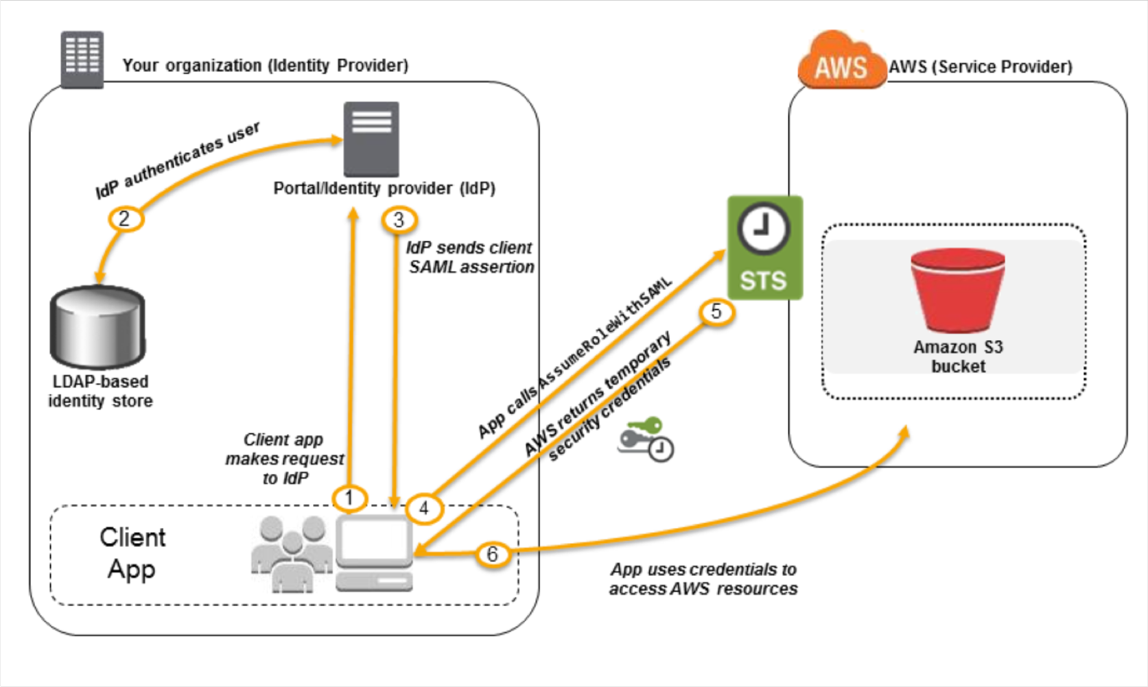
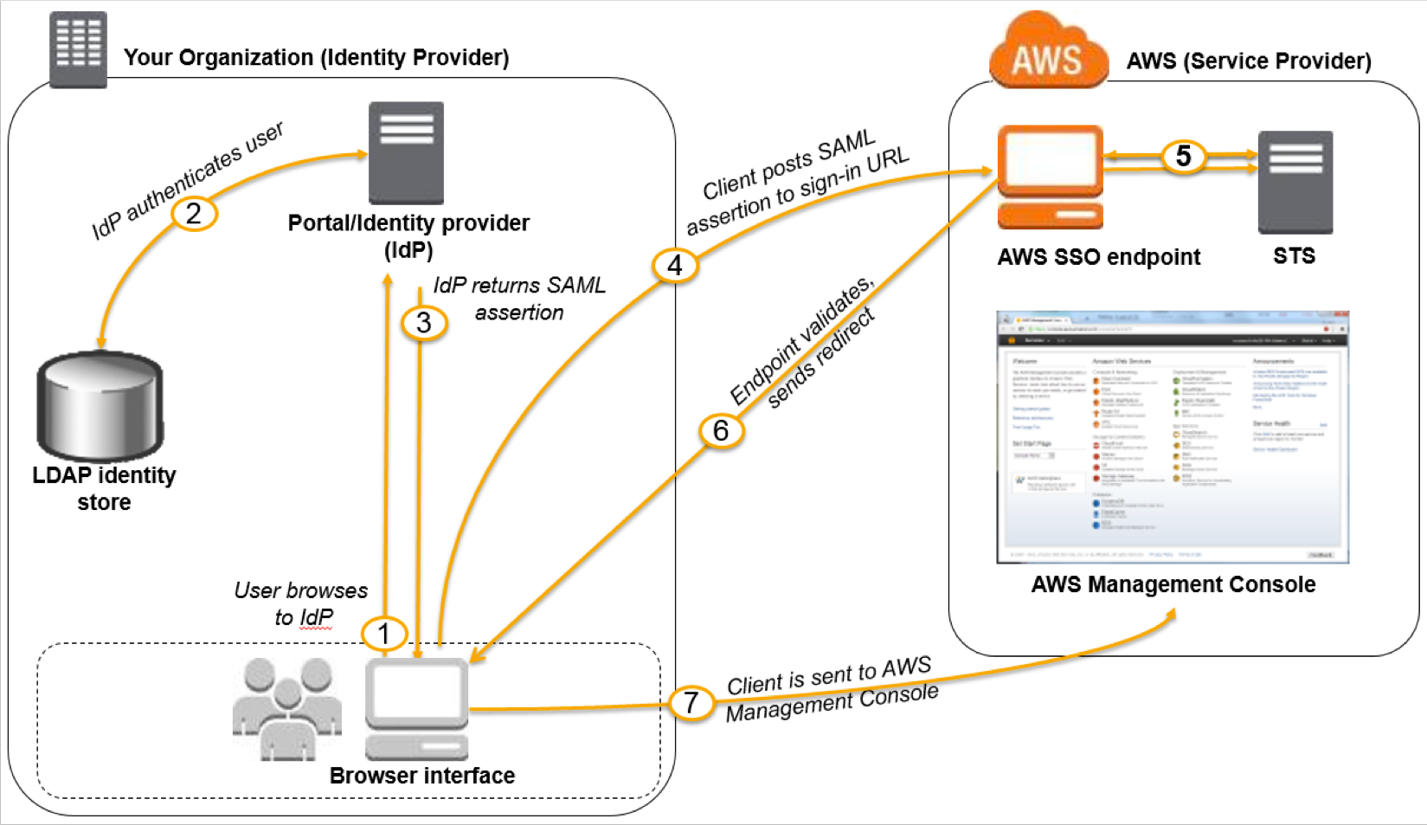
SAML Federation
NOT FOR DISTRIBUTION © Stephane Maarek www.datacumulus.com
For Enterprises
To integrate Active Directory / ADFS with AWS (or any SAML 2.0)
Provides access to AWS Console or CLI (through temporary creds)
No need to create an IAM user for each of your employees
https://docs.aws.amazon.com/IAM/latest/UserGuide/id_roles_providers_saml.html
https://docs.aws.amazon.com/IAM/latest/UserGuide/id_roles_providers_enable-console-saml.html
© Stephane Maarek

Slide 145
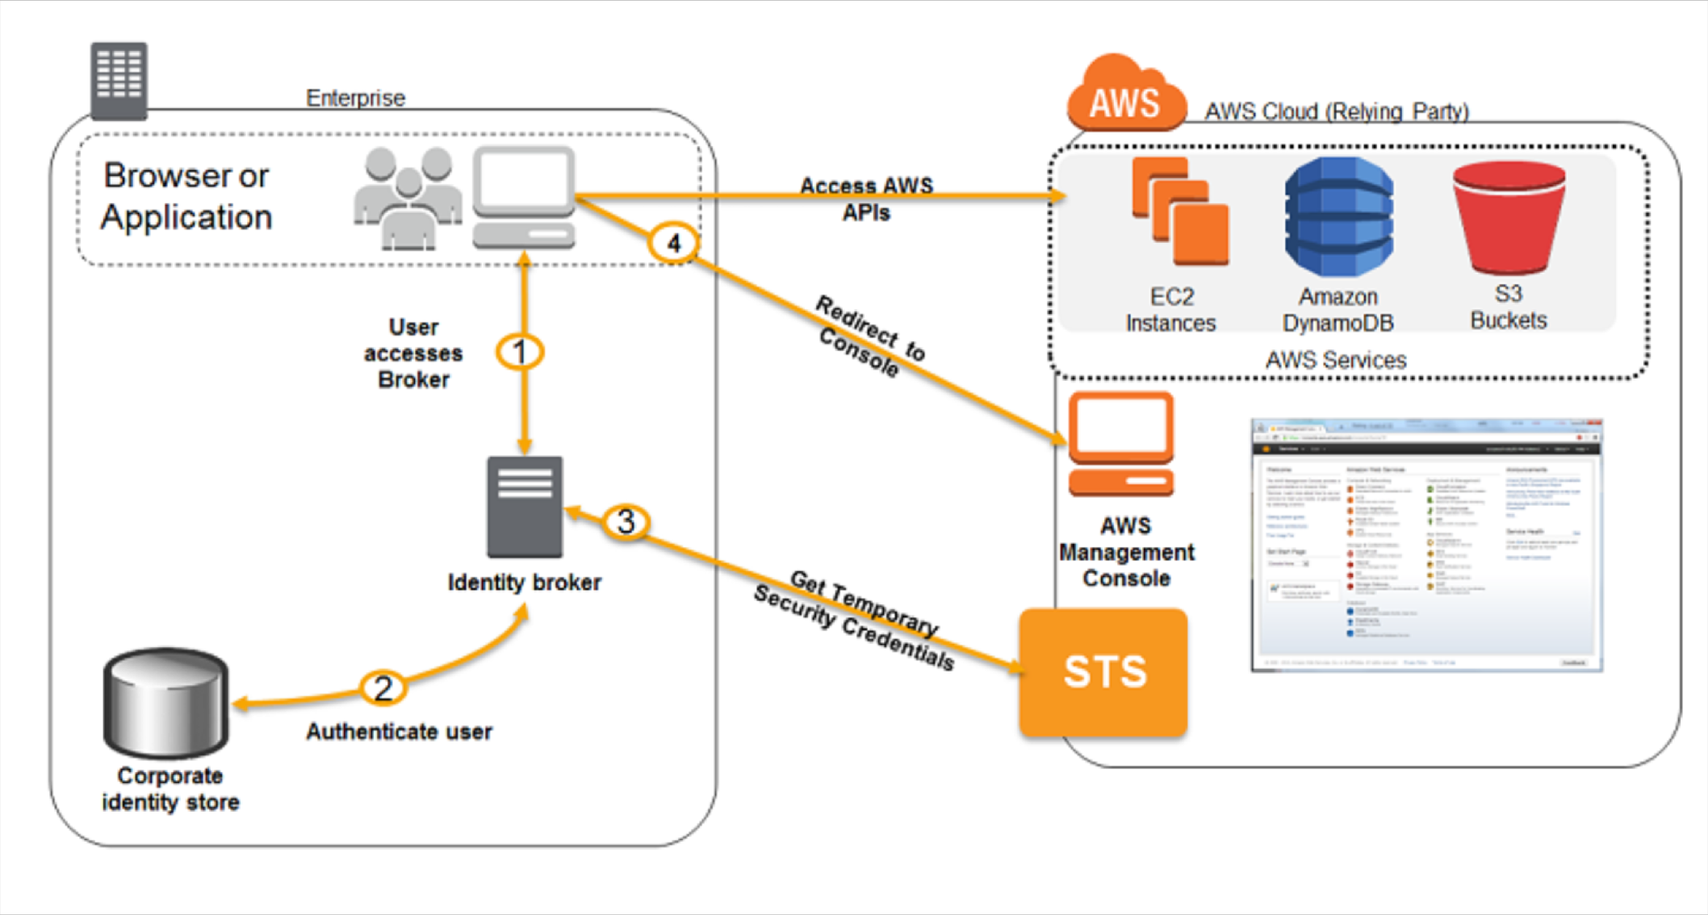
Custom Identity Broker Application
NOT FOR DISTRIBUTION © Stephane Maarek www.datacumulus.com
For Enterprises
Use only if identity provider is not compatible with SAML 2.0
The identity broker must determine the appropriate IAM policy
https://docs.aws.amazon.com/IAM/latest/UserGuide/id_roles_ common-scenarios_federated-users.html
© Stephane Maarek

Slide 146
AWS Cognito - Federated Identity Pools
NOT FOR DISTRIBUTION © Stephane Maarek www.datacumulus.com
For Public Applications
Goal:
Provide direct access to AWS Resources from the Client Side
How:
Log in to federated identity provider – or remain anonymous
Get temporary AWS credentials back from the Federated Identity Pool
These credentials come with a pre-defined IAM policy stating their permissions
Example:
provide (temporary) access to write to S3 bucket using Facebook Login
Note:
Web Identity Federation is an alternative to using Cognito but AWS recommends against it
Identity Provider
Twitter SAML
OpenID
….
CUP Google
Facebook
login
token
verify token
Authenticate to FIP
App
call
temp AWS credentials
Federated Identity
Get credentials
Amazon S3 bucket
© Stephane Maarek

Slide 147
AWS Shared Responsibility Model
NOT FOR DISTRIBUTION © Stephane Maarek www.datacumulus.com
AWS responsibility - Security of the Cloud
Protecting infrastructure (hardware, software, facilities, and networking) that runs all of the AWS services
Managed services like S3, DynamoDB, RDS etc
Customer responsibility - Security in the Cloud
For EC2 instance, customer is responsible for management of the guest OS (including security patches and updates), firewall & network configuration, IAM etc
© Stephane Maarek

Slide 148

Example, for RDS
NOT FOR DISTRIBUTION © Stephane Maarek www.datacumulus.com
AWS responsibility:
Manage the underlying EC2 instance, disable SSH access
Automated DB patching
Automated OS patching
Audit the underlying instance and disks & guarantee it functions
Your responsibility:
Check the ports / IP / security group inbound rules in DB’s SG
In-database user creation and permissions
Creating a database with or without public access
Ensure parameter groups or DB is configured to only allow SSL connections
Database encryption setting
© Stephane Maarek

Slide 149

Example, for S3
NOT FOR DISTRIBUTION © Stephane Maarek www.datacumulus.com
AWS responsibility:
Guarantee you get unlimited storage
Guarantee you get encryption
Ensure separation of the data between different customers
Ensure AWS employees can’t access your data
Your responsibility:
Bucket configuration
Bucket policy / public setting
IAM user and roles
Enabling encryption
© Stephane Maarek

Slide 150
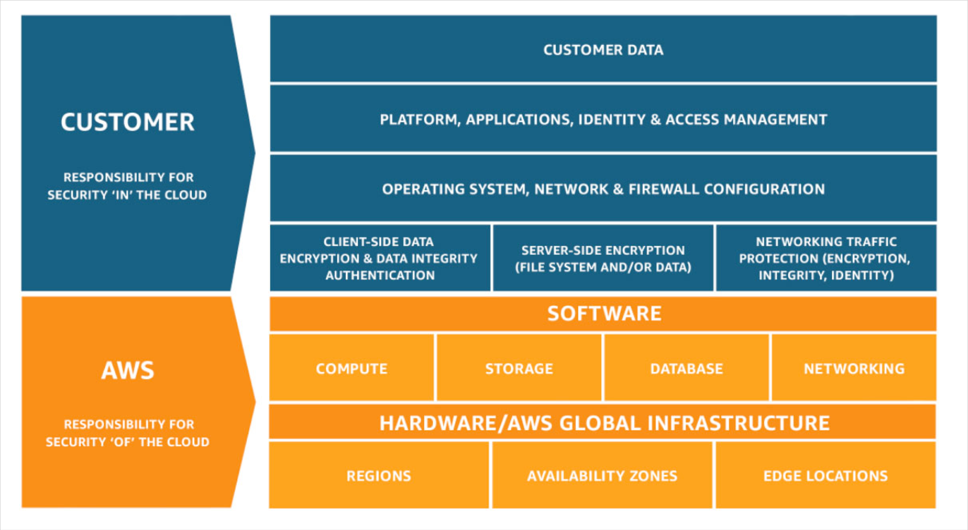
Shared Responsibility Model diagram
NOT FOR DISTRIBUTION © Stephane Maarek www.datacumulus.com
https://aws.amazon.com/compliance/shared-responsibility-model/
© Stephane Maarek

Slide 151
Networking - VPC
NOT FOR DISTRIBUTION © Stephane Maarek www.datacumulus.com
NO
T
F O R
D
I S T
R
I B
U
T I O
N
©
S
t e p
h a n e
Ma
Networking - VPC
a
r e k
www
.
d a t a
c u m
u
l u
s
.
c o
© Stephane Maarek ^{m}
© Stephane Maarek

Slide 152


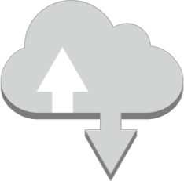
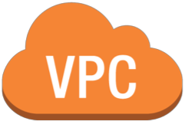









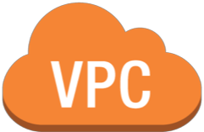












VPC Diagram
NOT FOR DISTRIBUTION © Stephane Maarek www.datacumulus.com
www
Internet gateway
Internet
VPC Flow Logs
Amazon DynamoDB
Router
+ Route Table
Amazon CloudWatch
Public EC2
VPC NAT
gateway
Public Subnet
network access control list
security group
endpoints
Amazon S3
Corporate DC
VPC
peering
Router
+ Route Table
Private EC2
Private EC2
network access control list
security group
Private Subnet
security group
AZ A
VPN gateway
Site to Site VPN Connetion
customer gateway
© Stephane Maarek

Slide 153
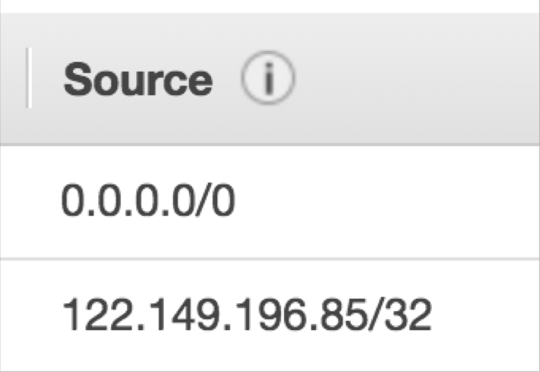
Understanding CIDR - IPv4 (Classless Inter-Domain Routing)
NOT FOR DISTRIBUTION © Stephane Maarek www.datacumulus.com
CIDR are used for Security Groups rules, or AWS networking in general
They help to define an IP address range
We’ve seen WW.XX.YY.ZZ/32 == one IP
We’ve seen 0.0.0.0/0 == all IPs
But we can define for ex: 192.168.0.0/26: 192.168.0.0 – 192.168.0.63 (64 IP)
© Stephane Maarek

Slide 154
Understanding CIDR
NOT FOR DISTRIBUTION © Stephane Maarek www.datacumulus.com
A CIDR has two components:
The base IP (XX.XX.XX.XX)
The Subnet Mask (/26)
The base IP represents an IP contained in the range
The subnet masks defines how many bits can change in the IP
The subnet mask can take two forms. Examples:
255.255.255.0
/24
⬅ less common
⬅ more common
© Stephane Maarek

Slide 155
Understanding CIDRs Subnet Masks
NOT FOR DISTRIBUTION © Stephane Maarek www.datacumulus.com
The subnet masks basically allows part of the underlying IP to get additional next values from the base IP
/32 allows for 1 IP = 2^0
/31 allows for 2 IP = 2^1
/30 allows for 4 IP = 2^2
/29 allows for 8 IP = 2^3
/28 allows for 16 IP = 2^4
/27 allows for 32 IP = 2^5
/26 allows for 64 IP = 2^6
/25 allows for 128 IP = 2^7
/24 allows for 256 IP = 2^8
/16 allows for 65,536 IP = 2^16
/0 allows for all IPs = 2^32
Quick memo:
/32 – no IP number can change
/24 - last IP number can change
/16 – last IP two numbers can change
/8 – last IP three numbers can change
/0 – all IP numbers can change
© Stephane Maarek

Slide 156
Understanding CIDRs Little exercise
NOT FOR DISTRIBUTION © Stephane Maarek www.datacumulus.com
192.168.0.0/24 = … ?
192.168.0.0 – 192.168.0.255 (256 IP)
192.168.0.0/16 = … ?
192.168.0.0 – 192.168.255.255 (65,536 IP)
134.56.78.123/32 = … ?
Just 134.56.78.123
0.0.0.0/0
All IP!
When in doubt, use this website: https://www.ipaddressguide.com/cidr
© Stephane Maarek

Slide 157
Private vs Public IP (IPv4) Allowed ranges
NOT FOR DISTRIBUTION © Stephane Maarek www.datacumulus.com
The Internet Assigned Numbers Authority (IANA) established certain blocks of IPV4 addresses for the use of private (LAN) and public (Internet) addresses.
Private IP can only allow certain values
10.0.0.0 – 10.255.255.255 (10.0.0.0/8) <= in big networks
172.16.0.0 – 172.31.255.255 (172.16.0.0/12) <= default AWS one
192.168.0.0 – 192.168.255.255 (192.168.0.0/16) <= example: home networks
All the rest of the IP on the internet are public IP
© Stephane Maarek

Slide 158
Default VPC Walkthrough
NOT FOR DISTRIBUTION © Stephane Maarek www.datacumulus.com
All new accounts have a default VPC
New instances are launched into default VPC if no subnet is specified
Default VPC have internet connectivity and all instances have public IP
We also get a public and a private DNS name
© Stephane Maarek

Slide 159
VPC in AWS – IPv4
NOT FOR DISTRIBUTION © Stephane Maarek www.datacumulus.com
VPC = Virtual Private Cloud
You can have multiple VPCs in a region (max 5 per region – soft limit)
Max CIDR per VPC is 5. For each CIDR:
Min size is /28 = 16 IP Addresses
Max size is /16 = 65536 IP Addresses
Because VPC is private, only the Private IP ranges are allowed:
10.0.0.0 – 10.255.255.255 (10.0.0.0/8)
172.16.0.0 – 172.31.255.255 (172.16.0.0/12)
192.168.0.0 – 192.168.255.255 (192.168.0.0/16)
Your VPC CIDR should not overlap with your other networks (ex: corporate)
© Stephane Maarek

Slide 160
State of Hands On
NOT FOR DISTRIBUTION © Stephane Maarek www.datacumulus.com
© Stephane Maarek

Slide 161
Adding Subnets
NOT FOR DISTRIBUTION © Stephane Maarek www.datacumulus.com
Public Subnet
Private Subnet
AZ A
© Stephane Maarek

Slide 162
Subnets - IPv4
NOT FOR DISTRIBUTION © Stephane Maarek www.datacumulus.com
AWS reserves 5 IPs address (first 4 and last 1 IP address) in each Subnet
These 5 IPs are not available for use and cannot be assigned to an instance
Ex, if CIDR block 10.0.0.0/24, reserved IP are:
10.0.0.0: Network address
10.0.0.1: Reserved by AWS for the VPC router
10.0.0.2: Reserved by AWS for mapping to Amazon-provided DNS
10.0.0.3: Reserved by AWS for future use
10.0.0.255: Network broadcast address. AWS does not support broadcast in a VPC, therefore the address is reserved
Exam Tip:
If you need 29 IP addresses for EC2 instances, you can’t choose a Subnet of size /27 (32 IP)
You need at least 64 IP, Subnet size /26 (64-5 = 59 > 29, but 32-5 = 27 < 29)
© Stephane Maarek

Slide 163
Internet Gateways
NOT FOR DISTRIBUTION © Stephane Maarek www.datacumulus.com
Internet gateways helps our VPC instances connect with the internet
It scales horizontally and is HA and redundant
Must be created separately from VPC
One VPC can only be attached to one IGW and vice versa
Internet Gateway is also a NAT for the instances that have a public IPv4
Internet Gateways on their own do not allow internet access…
Route tables must also be edited!
© Stephane Maarek

Slide 164
Adding IGW
NOT FOR DISTRIBUTION © Stephane Maarek www.datacumulus.com
Internet gateway
Public Subnet
Private Subnet
AZ A
© Stephane Maarek

Slide 165
Editing Route Tables
NOT FOR DISTRIBUTION © Stephane Maarek www.datacumulus.com
www
Internet gateway
Internet
Router
+ Route Table
Public EC2
Public Subnet
security group
Private Subnet
AZ A
© Stephane Maarek

Slide 166
NAT Instances – Network Address Translation (outdated but still at the exam)
NOT FOR DISTRIBUTION © Stephane Maarek www.datacumulus.com
Allows instances in the private subnets to connect to the internet
Must be launched in a public subnet
Must disable EC2 flag: Source / Destination Check
Must have Elastic IP attached to it
Route table must be configured to route traffic from private subnets to NAT Instance
© Stephane Maarek

Slide 167


NAT Instance
NOT FOR DISTRIBUTION © Stephane Maarek www.datacumulus.com
www
Internet gateway
Internet
Router
+ Route Table
NAT
Instance
Public EC2
security group
Public Subnet
security group
Router
+ Route Table
Private EC2
security group
Private Subnet
AZ A
© Stephane Maarek

Slide 168
NAT Instances – Comments
NOT FOR DISTRIBUTION © Stephane Maarek www.datacumulus.com
Amazon Linux AMI pre-configured are available
Not highly available / resilient setup out of the box
• => Would need to create ASG in multi AZ + resilient user-data script
Internet traffic bandwidth depends on EC2 instance performance
Must manage security groups & rules:
Inbound:
Allow HTTP / HTTPS Traffic coming from Private Subnets
Allow SSH from your home network (access is provided through Internet Gateway)
Outbound:
Allow HTTP / HTTPS traffic to the internet
© Stephane Maarek

Slide 169
NAT Gateway
NOT FOR DISTRIBUTION © Stephane Maarek www.datacumulus.com
AWS managed NAT, higher bandwidth, better availability, no admin
Pay by the hour for usage and bandwidth
NAT is created in a specific AZ, uses an EIP
Cannot be used by an instance in that subnet (only from other subnets)
Requires an IGW (Private Subnet => NAT => IGW)
5 Gbps of bandwidth with automatic scaling up to 45 Gbps
No security group to manage / required
© Stephane Maarek

Slide 170
NAT Gateway
NOT FOR DISTRIBUTION © Stephane Maarek www.datacumulus.com
www
Internet gateway
Internet
Router
+ Route Table
Public EC2
VPC NAT
gateway
Public Subnet
security group
Router
+ Route Table
Private EC2
security group
Private Subnet
AZ A
© Stephane Maarek

Slide 171
NAT Instance vs Gateway
NOT FOR DISTRIBUTION © Stephane Maarek www.datacumulus.com
See: https://docs.aws.amazon.com/vpc/latest/userguide/vpc-nat- comparison.html
© Stephane Maarek

Slide 172
DNS Resolution in VPC
NOT FOR DISTRIBUTION © Stephane Maarek www.datacumulus.com
enableDnsSupport: (= DNS Resolution setting)
Default True
Helps decide if DNS resolution is supported for the VPC
If True, queries the AWS DNS server at 169.254.169.253
enableDnsHostname: (= DNS Hostname setting)
False by default for newly created VPC,True by default for Default VPC
Won’t do anything unless enableDnsSupport=true
If True, Assign public hostname to EC2 instance if it has a public
If you use custom DNS domain names in a private zone in Route 53, you must set both these attributes to true
© Stephane Maarek

Slide 173


Network ACLs & Security Group Incoming Request
NOT FOR DISTRIBUTION © Stephane Maarek www.datacumulus.com
Security Group Inbound Rules
NACL Inbound Rules
EC2
network access
control list
Outbound allowed (stateful)
NACL Outbound Rules (stateless)
security group
Subnet Level
subnet
© Stephane Maarek

Slide 174
Network ACLs & Security Group Outgoing Request
NOT FOR DISTRIBUTION © Stephane Maarek www.datacumulus.com
Security Group Outbound Rules
NACL Outbound Rules
EC2
network access
control list
Inbound allowed (stateful)
NACL Inbound Rules (stateless)
security group
Subnet Level
subnet
© Stephane Maarek

Slide 175
Network ACLs
NOT FOR DISTRIBUTION © Stephane Maarek www.datacumulus.com
NACL are like a firewall which control traffic from and to subnet
Default NACL allows everything outbound and everything inbound
One NACL per Subnet, new Subnets are assigned the Default NACL
Define NACL rules:
Rules have a number (1-32766) and higher precedence with a lower number
E.g. If you define #100 ALLOW <IP> and #200 DENY <IP> , IP will be allowed
Last rule is an asterisk (*) and denies a request in case of no rule match
AWS recommends adding rules by increment of 100
Newly created NACL will deny everything
NACL are a great way of blocking a specific IP at the subnet level
© Stephane Maarek

Slide 176
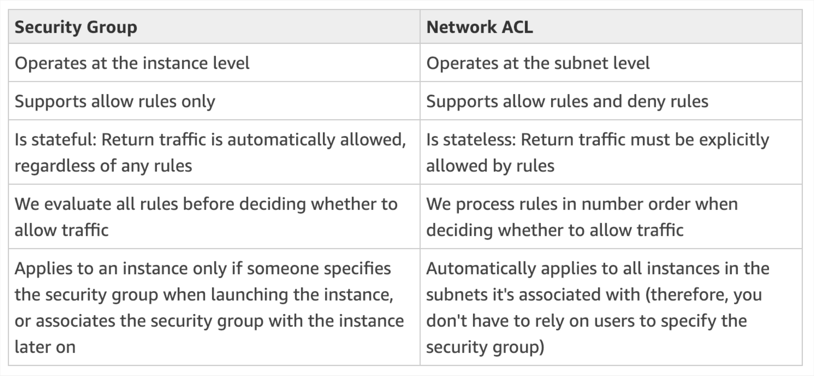
Network ACLs vs Security Groups
NOT FOR DISTRIBUTION © Stephane Maarek www.datacumulus.com
https://docs.aws.amazon.com/vpc/latest/userguide/VPC_Secur ity.html#VPC_Security_Comparison
© Stephane Maarek

Slide 177
Example Network ACL with Ephemeral Ports
NOT FOR DISTRIBUTION © Stephane Maarek www.datacumulus.com
https://docs.aws.amazon.com/vpc/latest/userguide/vpc-network-acls.html
© Stephane Maarek

Slide 178






VPC Peering
NOT FOR DISTRIBUTION © Stephane Maarek www.datacumulus.com
Connect two VPC, privately using AWS’ network
Make them behave as if they were in the same network
Must not have overlapping CIDR
VPC Peering connection is not transitive (must be established for each VPC that need to communicate with one another)
You can do VPC peering with another AWS account
You must update route tables in each VPC’s subnets to ensure instances can communicate
VPC peering A← →B
VPC B
VPC peering B← →C
VPC A
VPC C
VPC peering A← →C
© Stephane Maarek

Slide 179
VPC Peering
NOT FOR DISTRIBUTION © Stephane Maarek www.datacumulus.com
www
Internet gateway
Internet
VPC Flow Logs
Router
+ Route Table
Public EC2
VPC NAT
gateway
Public Subnet
network access control list
security group
VPC
peering
Router
+ Route Table
Private EC2
network access control list
security group
Private Subnet
AZ A
© Stephane Maarek

Slide 180
VPC Endpoints
NOT FOR DISTRIBUTION © Stephane Maarek www.datacumulus.com
www
Internet gateway
Internet
VPC Flow Logs
Amazon DynamoDB
Router
+ Route Table
Amazon CloudWatch
Public EC2
VPC NAT
gateway
Public Subnet
network access control list
security group
endpoints
Amazon S3
VPC
peering
Router
+ Route Table
Private EC2
Private EC2
network access control list
security group
Private Subnet
security group
AZ A
© Stephane Maarek

Slide 181
VPC Endpoints
NOT FOR DISTRIBUTION © Stephane Maarek www.datacumulus.com
Endpoints allow you to connect to AWS Services using a private network instead of the public www network
They scale horizontally and are redundant
They remove the need of IGW, NAT, etc… to access AWS Services
Interface: provisions an ENI (private IP address) as an entry point (must attach security group) – most AWS services
Gateway: provisions a target and must be used in a route table – S3 and DynamoDB
In case of issues:
Check DNS Setting Resolution in your VPC
Check Route Tables
© Stephane Maarek

Slide 182
Flow Logs
NOT FOR DISTRIBUTION © Stephane Maarek www.datacumulus.com
Capture information about IP traffic going into your interfaces:
VPC Flow Logs
Subnet Flow Logs
Elastic Network Interface Flow Logs
Helps to monitor & troubleshoot connectivity issues
Flow logs data can go to S3 / CloudWatch Logs
Captures network information from AWS managed interfaces too: ELB, RDS, ElastiCache, Redshift, WorkSpaces
© Stephane Maarek

Slide 183
VPC Flow Logs
NOT FOR DISTRIBUTION © Stephane Maarek www.datacumulus.com
www
Internet gateway
Internet
VPC Flow Logs
Amazon DynamoDB
Router
+ Route Table
Amazon CloudWatch
Public EC2
VPC NAT
gateway
Public Subnet
network access control list
security group
endpoints
Amazon S3
VPC
peering
Router
+ Route Table
Private EC2
Private EC2
network access control list
security group
Private Subnet
security group
AZ A
© Stephane Maarek

Slide 184
Flow Log Syntax
NOT FOR DISTRIBUTION © Stephane Maarek www.datacumulus.com
<version> <account-id> <interface-id> <srcaddr> <dstaddr> <srcport>
<dstport> <protocol> <packets> <bytes> <start> <end> <action> <log- status>
Srcaddr, dstaddr help identify problematic IP
Srcport, dstport help identity problematic ports
Action : success or failure of the request due to Security Group / NACL
Can be used for analytics on usage patterns, or malicious behavior
Flow logs example: https://docs.aws.amazon.com/vpc/latest/userguide/flow- logs.html#flow-log-records
Query VPC flow logs using Athena on S3 or CloudWatch Logs Insights
© Stephane Maarek

Slide 185


Flow Logs: Looking at “ACTION” field How to troubleshoot SG vs NACL issue?
NOT FOR DISTRIBUTION © Stephane Maarek www.datacumulus.com
For incoming requests
Inbound REJECT: NACL or SG
Inbound ACCEPT, outbound REJECT: NACL
For outgoing requests
Outbound REJECT: NACL or SG
Outbound ACCEPT, inbound REJECT: NACL
© Stephane Maarek

Slide 186

Bastion Hosts
NOT FOR DISTRIBUTION © Stephane Maarek www.datacumulus.com
We can use a Bastion Host to SSH into our private instances
The bastion is in the public subnet which
is then connected to all other private subnets
Bastion Host security group must be tightened
Exam Tip: Make sure the bastion host
only has port 22 traffic from the IP you
need, not from the security groups of your other instances
© Stephane Maarek

Slide 187
Site to Site VPN
NOT FOR DISTRIBUTION © Stephane Maarek www.datacumulus.com
www
Internet gateway
Internet
VPC Flow Logs
Amazon DynamoDB
Router
+ Route Table
Amazon CloudWatch
Public EC2
VPC NAT
gateway
Public Subnet
network access control list
security group
endpoints
Amazon S3
Corporate DC
VPC
peering
Router
+ Route Table
Private EC2
Private EC2
network access control list
security group
Private Subnet
security group
AZ A
VPN gateway
Site to Site VPN Connetion
customer gateway
© Stephane Maarek

Slide 188
Site to Site VPN
NOT FOR DISTRIBUTION © Stephane Maarek www.datacumulus.com
Virtual Private Gateway:
VPN concentrator on the AWS side of the VPN connection
VGW is created and attached to the VPC from which you want to create the Site-to- Site VPN connection
Possibility to customize the ASN
Customer Gateway:
Software application or physical device on customer side of the VPN connection
https://docs.aws.amazon.com/vpc/latest/adminguide/Introduction.html#DevicesTested
IP Address:
Use static, internet-routable IP address for your customer gateway device.
If behind a CGW behind NAT (with NAT-T), use the public IP address of the NAT
© Stephane Maarek

Slide 189

Direct Connect
NOT FOR DISTRIBUTION © Stephane Maarek www.datacumulus.com
Provides a dedicated private connection from a remote network to your VPC
Dedicated connection must be setup between your DC and AWS Direct Connect locations
You need to setup a Virtual Private Gateway on your VPC
Access public resources (S3) and private (EC2) on same connection
Use Cases:
Increase bandwidth throughput - working with large data sets – lower cost
More consistent network experience - applications using real-time data feeds
Hybrid Environments (on prem + cloud)
Supports both IPv4 and IPv6
© Stephane Maarek

Slide 190

Direct Connect Diagram
NOT FOR DISTRIBUTION © Stephane Maarek www.datacumulus.com
https://docs.aws.amazon.com/directconnect/latest/UserGuide
/images/direct_connect_overview.png
© Stephane Maarek

Slide 191

Direct Connect Gateway
NOT FOR DISTRIBUTION © Stephane Maarek www.datacumulus.com
If you want to setup a Direct Connect to one or more VPC in many different regions (same account), you must use a Direct Connect Gateway
https://docs.aws.amazon.com/directconnect/latest/UserGuide
/direct-connect-gateways.html
© Stephane Maarek

Slide 192

Egress Only Internet Gateway
NOT FOR DISTRIBUTION © Stephane Maarek www.datacumulus.com
Egress only Internet Gateway is for IPv6 only
Similar function as a NAT, but a NAT is for IPv4
Good to know: IPv6 are all public addresses
Therefore all our instances with IPv6 are publicly accessibly
Egress Only Internet Gateway gives our IPv6 instances access to the internet, but they won’t be directly reachable by the internet
After creating an Egress Only Internet Gateway, edit the route tables
© Stephane Maarek

Slide 193
VPC Diagram
NOT FOR DISTRIBUTION © Stephane Maarek www.datacumulus.com
www
Internet gateway
Internet
VPC Flow Logs
Amazon DynamoDB
Router
+ Route Table
Amazon CloudWatch
Public EC2
VPC NAT
gateway
Public Subnet
network access control list
security group
endpoints
Amazon S3
Corporate DC
VPC
peering
Router
+ Route Table
Private EC2
Private EC2
network access control list
security group
Private Subnet
security group
AZ A
VPN gateway
Site to Site VPN Connetion
customer gateway
© Stephane Maarek

Slide 194
VPC Section Summary (1/2)
NOT FOR DISTRIBUTION © Stephane Maarek www.datacumulus.com
CIDR: IP Range
VPC: Virtual Private Cloud => we define a list of IPv4 & IPv6 CIDR
Subnets: Tied to an AZ, we define a CIDR
Internet Gateway: at the VPC level, provide IPv4 & IPv6 Internet Access
Route Tables: must be edited to add routes from subnets to the IGW,VPC Peering Connections,VPC Endpoints, etc…
NAT Instances: gives internet access to instances in private subnets. Old, must be setup in a public subnet, disable Source / Destination check flag
NAT Gateway: managed by AWS, provides scalable internet access to private instances, IPv4 only
Private DNS + Route 53: enable DNS Resolution + DNS hostnames (VPC)
NACL: Stateless, subnet rules for inbound and outbound, don’t forget ephemeral ports
Security Groups: Stateful, operate at the EC2 instance level
© Stephane Maarek

Slide 195
VPC Section Summary (2/2)
NOT FOR DISTRIBUTION © Stephane Maarek www.datacumulus.com
VPC Peering: Connect two VPC with non overlapping CIDR, non transitive
VPC Endpoints: Provide private access to AWS Services (S3, DynamoDB, CloudFormation, SSM) within VPC
VPC Flow Logs: Can be setup at the VPC / Subnet / ENI Level, for ACCEPT and REJECT traffic, helps identifying attacks, analyze using Athena or CloudWatch Log Insights
Bastion Host: Public instance to SSH into, that has SSH connectivity to instances in private subnets
Site to Site VPN: setup a Customer Gateway on DC, a Virtual Private Gateway on VPC, and site-to-site VPN over public internet
Direct Connect: setup a Virtual Private Gateway on VPC, and establish a direct private connection to an AWS Direct Connect Location
Direct Connect Gateway: setup a Direct Connect to many VPC in different regions
Internet Gateway Egress: like a NAT Gateway, but for IPv6
© Stephane Maarek

Slide 196
NOT FOR DISTRIBUTION © Stephane Maarek www.datacumulus.com
Other Services
Overview of Services that might come up in a few questions
© Stephane Maarek

Slide 197
Continuous Integration
NOT FOR DISTRIBUTION © Stephane Maarek www.datacumulus.com
Developers push the code to a code
repository often (GitHub / CodeCommit / Bitbucket / etc…)
A testing / build server checks the code as
soon as it’s pushed (CodeBuild / Jenkins CI
/ etc…)
The developer gets feedback about the tests and checks that have passed / failed
Tell developer results of build
Push code often
Build Server
Code Repository
Find bugs early, fix bugs
Deliver faster as the code is tested
Deploy often
Happier developers, as they’re unblocked
Get code build & test
© Stephane Maarek

Slide 198
Continuous Delivery
NOT FOR DISTRIBUTION © Stephane Maarek www.datacumulus.com
Ensure that the software can be released reliably whenever needed.
Ensures deployments happen often and are quick
Shift away from “one release every 3 months” to ”5 releases a day”
That usually means automated deployment
CodeDeploy
Jenkins CD
Push code often
Code Repository
Get code build & test
Build Server
Deploy every passing build
Deployment Server
Spinnaker
Etc…
Application Server v1
Application Server v1
Application Server v1
Application Server v2
Application Server v2
Application Server v2
© Stephane Maarek

Slide 199
Technology Stack for CICD
NOT FOR DISTRIBUTION © Stephane Maarek www.datacumulus.com
Code
Build
Test
Deploy
Provision
AWS
CodeCommit
AWS CodeBuild
AWS Elastic Beanstalk
AWS CodeDeploy | User Managed EC2 Instances Fleet (CloudFormation)
GitHub Or 3rd party
code repository
Jenkins CI
Or 3rd party CI servers
Orchestrate: AWS CodePipeline
© Stephane Maarek

Slide 200
Infrastructure as Code
NOT FOR DISTRIBUTION © Stephane Maarek www.datacumulus.com
Currently, we have been doing a lot of manual work
All this manual work will be very tough to reproduce:
In another region
in another AWS account
Within the same region if everything was deleted
Wouldn’t it be great, if all our infrastructure was… code?
That code would be deployed and create / update / delete our infrastructure
© Stephane Maarek

Slide 201

What is CloudFormation
NOT FOR DISTRIBUTION © Stephane Maarek www.datacumulus.com
CloudFormation is a declarative way of outlining your AWS Infrastructure, for any resources (most of them are supported).
For example, within a CloudFormation template, you say:
I want a security group
I want two EC2 machines using this security group
I want two Elastic IPs for these EC2 machines
I want an S3 bucket
I want a load balancer (ELB) in front of these machines
Then CloudFormation creates those for you, in the right order, with the
exact configuration that you specify
© Stephane Maarek

Slide 202
Benefits of AWS CloudFormation (1/2)
NOT FOR DISTRIBUTION © Stephane Maarek www.datacumulus.com
Infrastructure as code
No resources are manually created, which is excellent for control
The code can be version controlled for example using git
Changes to the infrastructure are reviewed through code
Cost
Each resources within the stack is tagged with an identifier so you can easily see how much a stack costs you
You can estimate the costs of your resources using the CloudFormation template
Savings strategy: In Dev, you could automation deletion of templates at 5 PM and recreated at 8 AM, safely
© Stephane Maarek

Slide 203
Benefits of AWS CloudFormation (2/2)
NOT FOR DISTRIBUTION © Stephane Maarek www.datacumulus.com
Productivity
Ability to destroy and re-create an infrastructure on the cloud on the fly
Automated generation of Diagram for your templates!
Declarative programming (no need to figure out ordering and orchestration)
Separation of concern: create many stacks for many apps, and many layers. Ex:
VPC stacks
Network stacks
App stacks
Don’t re-invent the wheel
Leverage existing templates on the web!
Leverage the documentation
© Stephane Maarek

Slide 204
How CloudFormation Works
NOT FOR DISTRIBUTION © Stephane Maarek www.datacumulus.com
Templates have to be uploaded in S3 and then referenced in CloudFormation
To update a template, we can’t edit previous ones. We have to re- upload a new version of the template to AWS
Stacks are identified by a name
Deleting a stack deletes every single artifact that was created by CloudFormation.
© Stephane Maarek

Slide 205
Deploying CloudFormation templates
NOT FOR DISTRIBUTION © Stephane Maarek www.datacumulus.com
Manual way:
Editing templates in the CloudFormation Designer
Using the console to input parameters, etc
Automated way:
Editing templates in a YAML file
Using the AWS CLI (Command Line Interface) to deploy the templates
Recommended way when you fully want to automate your flow
© Stephane Maarek

Slide 206
CloudFormation Building Blocks
NOT FOR DISTRIBUTION © Stephane Maarek www.datacumulus.com
Templates components
Resources: your AWS resources declared in the template (MANDATORY)
Parameters: the dynamic inputs for your template
Mappings: the static variables for your template
Outputs: References to what has been created
Conditionals: List of conditions to perform resource creation
Metadata
Templates helpers:
References
Functions
© Stephane Maarek

Slide 207
Note:
This is an introduction to CloudFormation
NOT FOR DISTRIBUTION © Stephane Maarek www.datacumulus.com
It can take over 3 hours to properly learn and master CloudFormation
This lecture is meant so you get a good idea of how it works
The exam expects you to understand how to read CloudFormation
© Stephane Maarek

Slide 208

AWS ECS – Elastic Container Service
NOT FOR DISTRIBUTION © Stephane Maarek www.datacumulus.com
ECS is a container orchestration service
ECS helps you run Docker containers on EC2 machines
ECS is complicated, and made of:
“ECS Core”: Running ECS on user-provisioned EC2 instances
Fargate: Running ECS tasks on AWS-provisioned compute (serverless)
EKS: Running ECS on AWS-powered Kubernetes (running on EC2)
ECR: Docker Container Registry hosted by AWS
ECS & Docker are very popular for microservices
For now, for the exam, only “ECS Core” & ECR is in scope
IAM security and roles at the ECS task level
© Stephane Maarek

Slide 209

What’s Docker?
NOT FOR DISTRIBUTION © Stephane Maarek www.datacumulus.com
Docker is a “container technology”
Run a containerized application on any machine with Docker installed
Containers allows our application to work the same way anywhere
Containers are isolated from each other
Control how much memory / CPU is allocated to your container
Ability to restrict network rules
More efficient than Virtual machines
Scale containers up and down very quickly (seconds)
© Stephane Maarek

Slide 210
AWS ECS – Use cases
NOT FOR DISTRIBUTION © Stephane Maarek www.datacumulus.com
Run microservices
Ability to run multiple docker containers on the same machine
Easy service discovery features to enhance communication
Direct integration with Application Load Balancers
Auto scaling capability
Run batch processing / scheduled tasks
Schedule ECS containers to run on On-demand / Reserved / Spot instances
Migrate applications to the cloud
Dockerize legacy applications running on premise
Move Docker containers to run on ECS
© Stephane Maarek

Slide 211
AWS ECS – Concepts
NOT FOR DISTRIBUTION © Stephane Maarek www.datacumulus.com
ECS cluster: set of EC2 instances
ECS service: applications definitions running on ECS cluster
ECS tasks + definition: containers running to create the application
ECS IAM roles: roles assigned to tasks to interact with AWS
Task container
Task container
Task container
Task container
Task container
Task container
ECS Service
Task container
Task container
Other ECS Service
EC2
EC2
EC2
ECS Cluster
© Stephane Maarek

Slide 212

AWS ECS – ALB integration
NOT FOR DISTRIBUTION © Stephane Maarek www.datacumulus.com
Application Load Balancer (ALB) has a direct integration feature with ECS called “port mapping”
This allows you to run multiple instances of the same application on the same EC2 machine
Use cases:
Increased resiliency even if running on one EC2 instance
Maximize utilization of CPU / cores
Ability to perform rolling upgrades without impacting application uptime
Dynamic port mapping
Port 6789
container Node.js
Port 9586
container Node.js
Port 80 / 443
Port 3748
container Node.js
Application Load Balancer
Port 9856
container Node.js
EC2 instance
© Stephane Maarek

Slide 213

AWS ECS – ECS Setup & Config file
NOT FOR DISTRIBUTION © Stephane Maarek www.datacumulus.com
Run an EC2 instance, install the ECS agent with ECS config file
Or use an ECS-ready Linux AMI (still need to modify config file)
ECS Config file is at /etc/ecs/ecs.config
© Stephane Maarek

Slide 214




AWS ECR – Elastic Container Registry
NOT FOR DISTRIBUTION © Stephane Maarek www.datacumulus.com
Store, managed and deploy your containers on AWS
Fully integrated with IAM & ECS
Sent over HTTPS (encryption in flight) and encrypted at rest
Push Images (CICD)
container
Image A
container
pull
Image B
Amazon ECR
AWS CodeBuild
ECS instance
Request to pull docker images
IAM
© Stephane Maarek

Slide 215

AWS Step Functions
NOT FOR DISTRIBUTION © Stephane Maarek www.datacumulus.com
Build serverless visual workflow to orchestrate your Lambda functions
Represent flow as a JSON state machine
Features: sequence, parallel, conditions, timeouts, error handling…
Can also integrate with EC2, ECS, On premise servers, API Gateway
Maximum execution time of 1 year
Possibility to implement human approval feature
Use cases:
Order fulfillment
Data processing
Web applications
Any workflow
© Stephane Maarek

Slide 216



Visual workflow in Step Functions
NOT FOR DISTRIBUTION © Stephane Maarek www.datacumulus.com
© Stephane Maarek

Slide 217

AWS SWF – Simple Workflow Service
NOT FOR DISTRIBUTION © Stephane Maarek www.datacumulus.com
Coordinate work amongst applications
Code runs on EC2 (not serverless)
1 year max runtime
Concept of “activity step” and “decision step”
Has built-in “human intervention” step
Example: order fulfilment from web to warehouse to delivery
Step Functions is recommended to be used for new applications, except:
If you need external signals to intervene in the processes
If you need child processes that return values to parent processes
© Stephane Maarek

Slide 218

Amazon EMR
NOT FOR DISTRIBUTION © Stephane Maarek www.datacumulus.com
EMR stands for “Elastic MapReduce”
EMR helps creating Hadoop clusters (Big Data) to analyze and process vast amount of data
The clusters can be made of hundreds of EC2 instances
Also supports Apache Spark, HBase, Presto, Flink…
EMR takes care of all the provisioning and configuration
Auto-scaling and integrated with Spot instances
Use cases: data processing, machine learning, web indexing, big data…
© Stephane Maarek

Slide 219

AWS Glue
NOT FOR DISTRIBUTION © Stephane Maarek www.datacumulus.com
Fully-managed ETL (Extract,Transform & Load) service
Automating time consuming steps of data preparation for analytics
Serverless, pay as you go, fully managed, provisions Apache Spark
Crawls data sources and identifies data formats (schema inference)
Automated Code Generation
Sources: Amazon Aurora, RDS, Redshift & S3
Sinks: S3, Redshift, etc…
Glue Data Catalog: Metadata (definition & schema) of the Source Tables
© Stephane Maarek

Slide 220



AWS Opsworks
NOT FOR DISTRIBUTION © Stephane Maarek www.datacumulus.com
Chef & Puppet help you perform server configuration automatically, or repetitive actions
They work great with EC2 & On Premise VM
AWS Opsworks = Managed Chef & Puppet
It’s an alternative to AWS SSM
No hands on here, no knowledge of chef and puppet needed
In the exam: Chef & Puppet needed => AWS Opsworks
© Stephane Maarek

Slide 221
Quick word on Chef / Puppet
NOT FOR DISTRIBUTION © Stephane Maarek www.datacumulus.com
They help with managing configuration as code
Helps in having consistent deployments
Works with Linux / Windows
Can automate: user accounts, cron, ntp, packages, services…
They leverage “Recipes” or ”Manifests”
Chef / Puppet have similarities with SSM / Beanstalk / CloudFormation but they’re open-source tools that work cross-cloud
© Stephane Maarek

Slide 222

AWS Elastic Transcoder
NOT FOR DISTRIBUTION © Stephane Maarek www.datacumulus.com
Convert media files (video + music) stored in S3 into various formats for tablets, PC, Smartphone,TV, etc
Features: bit rate optimization, thumbnail, watermarks, captions, DRM, progressive download, encryption
4 Components:
Jobs: what does the work of the transcoder
Pipeline: Queue that manages the transcoding job
Presets:Template for converting media from one format to another
Notifications: SNS for example
Pay for what you use, scales automatically, fully managed
© Stephane Maarek

Slide 223

AWS Organizations
NOT FOR DISTRIBUTION © Stephane Maarek www.datacumulus.com
Global service
Allows to manage multiple AWS accounts
The main account is the master account – you can’t change it
Other accounts are member accounts
Member accounts can only be part of one organization
Consolidated Billing across all accounts - single payment method
Pricing benefits from aggregated usage (volume discount for EC2, S3…)
API is available to automate AWS account creation
© Stephane Maarek

Slide 224

OU & Service Control Policies (SCPs)
NOT FOR DISTRIBUTION © Stephane Maarek www.datacumulus.com
Organize accounts in Organizational Unit (OU)
Can be anything: dev / test / prod or Finance / HR / IT
Can nest OU within OU
Apply Service Control Policies (SCPs) to OU
Permit / Deny access to AWS services
SCP has a similar syntax to IAM
It’s a filter to IAM
Helpful for sandbox account creation
Helpful to separate dev and prod resources
Helpful to only allow approved services
© Stephane Maarek

Slide 225





AWS WorkSpaces
NOT FOR DISTRIBUTION © Stephane Maarek www.datacumulus.com
Managed, Secure Cloud Desktop
Great to eliminate management of on-premise VDI (Virtual Desktop Infrastructure)
On Demand, pay per by usage
Secure, Encrypted, Network Isolation
Integrated with Microsoft Access Directory
secure
Corporate data center
User
Virtual Desktop Linux / Windows
AWS Cloud
© Stephane Maarek

Slide 226


AWS AppSync
NOT FOR DISTRIBUTION © Stephane Maarek www.datacumulus.com
Store and sync data across mobile and web apps in real-time
Makes use of GraphQL (mobile technology from Facebook)
Client Code can be generated automatically
Integrations with DynamoDB / Lambda
Real-time subscriptions
Offline data synchronization (replaces Cognito Sync)
Fine Grained Security
© Stephane Maarek

Slide 227

AWS Single Sign On (SSO)
NOT FOR DISTRIBUTION © Stephane Maarek www.datacumulus.com
Centrally Managed Single Sign On across multiple AWS Accounts and Business Applications (Office 365, Salesforce, Box)
One login gets you access to everything securely
Integrated with Microsoft Active Directory
Helps reduce the process of setting up SSO in a company
Only helpful for Web Browser, SAML 2.0 enabled applications
© Stephane Maarek

Slide 228
NOT FOR DISTRIBUTION © Stephane Maarek www.datacumulus.com
White Papers and Architectures
Well Architected Framework, Disaster Recovery, etc…
© Stephane Maarek

Slide 229
Section Overview
NOT FOR DISTRIBUTION © Stephane Maarek www.datacumulus.com
Well Architected Framework Whitepaper
Well Architected Tool
AWS Trusted Advisor
Reference architectures resources (for real-world)
Disaster Recovery on AWS Whitepaper
© Stephane Maarek

Slide 230
Well Architected Framework General Guiding Principles
NOT FOR DISTRIBUTION © Stephane Maarek www.datacumulus.com
Stop guessing your capacity needs
Test systems at production scale
Automate to make architectural experimentation easier
Allow for evolutionary architectures
Design based on changing requirements
Drive architectures using data
Improve through game days
Simulate applications for flash sale days
© Stephane Maarek

Slide 231
Well Architected Framework 5 Pillars
NOT FOR DISTRIBUTION © Stephane Maarek www.datacumulus.com
1) Operational Excellence
2) Security
3) Reliability
4) Performance Efficiency
5) Cost Optimization
They are not something to balance, or trade-offs, they’re a synergy
© Stephane Maarek

Slide 232

Well Architected Framework
NOT FOR DISTRIBUTION © Stephane Maarek www.datacumulus.com
It’s also questions!
Let’s look into the Well-Architected Tool
https://console.aws.amazon.com/wellarchitected
AWS Well-Architected Tool
© Stephane Maarek

Slide 233
1) Operational Excellence
NOT FOR DISTRIBUTION © Stephane Maarek www.datacumulus.com
Includes the ability to run and monitor systems to deliver business value and to continually improve supporting processes and procedures
Design Principles
Perform operations as code - Infrastructure as code
Annotate documentation - Automate the creation of annotated documentation after every build
Make frequent, small, reversible changes - So that in case of any failure, you can reverse it
Refine operations procedures frequently - And ensure that team members are familiar with it
Anticipate failure
Learn from all operational failures
© Stephane Maarek

Slide 234












Operational Excellence AWS Services
NOT FOR DISTRIBUTION © Stephane Maarek www.datacumulus.com
Prepare
AWS CloudFormation
Operate
AWS Config
AWS CloudFormation
Evolve
AWS Config
AWS CloudTrail
Amazon CloudWatch
AWS X-Ray
AWS CloudFormation
AWS CodeBuild
AWS CodeCommit
AWS CodeDeploy
AWS CodePipeline
© Stephane Maarek

Slide 235
2) Security
NOT FOR DISTRIBUTION © Stephane Maarek www.datacumulus.com
Includes the ability to protect information, systems, and assets while delivering business value through risk assessments and mitigation strategies
Design Principles
Implement a strong identity foundation - Centralize privilege management and reduce (or even eliminate) reliance on long-term credentials - Principle of least privilege - IAM
Enable traceability - Integrate logs and metrics with systems to automatically respond and take action
Apply security at all layers - Like edge network,VPC, subnet, load balancer, every instance, operating system, and application
Automate security best practices
Protect data in transit and at rest - Encryption, tokenization, and access control
Keep people away from data - Reduce or eliminate the need for direct access or manual processing of data
Prepare for security events - Run incident response simulations and use tools with automation to increase your speed for detection, investigation, and recovery
© Stephane Maarek

Slide 236




















Security
AWS Services
NOT FOR DISTRIBUTION © Stephane Maarek www.datacumulus.com
Identity and Access Management
IAM
AWS-STS
MFA token
AWS Organizations
Detective Controls
AWS Config
Infrastructure Protection
AWS CloudTrail
Amazon CloudWatch
Amazon CloudFront
Amazon VPC
AWS Shield
AWS WAF
Amazon Inspector
Data Protection:
KMS
S3
Elastic Load Balancing (ELB)
Amazon EBS
Amazon RDS
Incident Response
IAM
AWS CloudFormation
Amazon CloudWatch Events
© Stephane Maarek

Slide 237
3) Reliability
NOT FOR DISTRIBUTION © Stephane Maarek www.datacumulus.com
Ability of a system to recover from infrastructure or service disruptions, dynamically acquire computing resources to meet demand, and mitigate disruptions such as misconfigurations or transient network issues
Design Principles
Test recovery procedures - Use automation to simulate different failures or to recreate scenarios that led to failures before
Automatically recover from failure - Anticipate and remediate failures before they occur
Scale horizontally to increase aggregate system availability - Distribute requests across multiple, smaller resources to ensure that they don't share a common point of failure
Stop guessing capacity - Maintain the optimal level to satisfy demand without over or under provisioning - Use Auto Scaling
Manage change in automation - Use automation to make changes to infrastructure
© Stephane Maarek

Slide 238













Reliability AWS Services
NOT FOR DISTRIBUTION © Stephane Maarek www.datacumulus.com
Foundations
IAM
Change Management
Amazon VPC
Service Limits
AWS Trusted Advisor
AWS Auto Scaling
Failure Management
Amazon CloudWatch
AWS CloudTrail
AWS Config
Backups
AWS CloudFormation
Amazon S3
Amazon S3 Glacier
Amazon Route 53
© Stephane Maarek

Slide 239
4) Performance Efficiency
NOT FOR DISTRIBUTION © Stephane Maarek www.datacumulus.com
Includes the ability to use computing resources efficiently to meet system requirements, and to maintain that efficiency as demand changes and technologies evolve
Design Principles
Democratize advanced technologies - Advance technologies become services and hence you can focus more on product development
Go global in minutes - Easy deployment in multiple regions
Use serverless architectures - Avoid burden of managing servers
Experiment more often - Easy to carry out comparative testing
Mechanical sympathy - Be aware of all AWS services
© Stephane Maarek

Slide 240













Performance Efficiency AWS Services
NOT FOR DISTRIBUTION © Stephane Maarek www.datacumulus.com
Selection
AWS Auto Scaling
AWS Lambda
Amazon Elastic Block Store (EBS)
Amazon Simple Storage Service (S3)
Amazon RDS
Review
Monitoring
AWS CloudFormation
Tradeoffs
Amazon CloudWatch
AWS Lambda
Amazon RDS
Amazon ElastiCache
AWS Snowball
Amazon CloudFront
© Stephane Maarek

Slide 241
5) Cost Optimization
NOT FOR DISTRIBUTION © Stephane Maarek www.datacumulus.com
Includes the ability to run systems to deliver business value at the lowest price point
Design Principles
Adopt a consumption mode - Pay only for what you use
Measure overall efficiency - Use CloudWatch
Stop spending money on data center operations - AWS does the infrastructure part and enables customer to focus on organization projects
Analyze and attribute expenditure - Accurate identification of system usage and costs, helps measure return on investment (ROI) - Make sure to use tags
Use managed and application level services to reduce cost of ownership - As managed services operate at cloud scale, they can offer a lower cost per transaction or service
© Stephane Maarek

Slide 242












Cost Optimization AWS Services
NOT FOR DISTRIBUTION © Stephane Maarek www.datacumulus.com
Expenditure Awareness
AWS Budgets
AWS Cost and Usage Report
AWS Cost Explorer
Reserved Instance Reporting
Cost-Effective Resources
Spot instance
Reserved instance
Matching supply and demand
Amazon S3 Glacier
Optimizing Over Time
AWS Auto Scaling
AWS Lambda
AWS Trusted Advisor
AWS Cost and Usage Report
© Stephane Maarek

Slide 243

Trusted Advisor
NOT FOR DISTRIBUTION © Stephane Maarek www.datacumulus.com
No need to install anything – high level AWS account assessment
Analyze your AWS accounts and provides recommendation:
Cost Optimization
Performance
Security
Fault Tolerance
Service Limits
Core Checks and recommendations – all customers
Can enable weekly email notification from the console
Full Trusted Advisor – Available for Business & Enterprise support plans
Ability to set CloudWatch alarms when reaching limits
© Stephane Maarek

Slide 244
More Architecture Examples
NOT FOR DISTRIBUTION © Stephane Maarek www.datacumulus.com
We’ve explored the most important architectural patterns:
Classic: EC2, ELB, RDS, ElastiCache, etc…
Serverless: S3, Lambda, DynamoDB, CloudFront, API Gateway, etc…
If you want to see more AWS architectures:
https://aws.amazon.com/architecture/
https://aws.amazon.com/solutions/
© Stephane Maarek

Slide 245
Disaster Recovery Overview
NOT FOR DISTRIBUTION © Stephane Maarek www.datacumulus.com
Any event that has a negative impact on a company’s business continuity or finances is a disaster
Disaster recovery (DR) is about preparing for and recovering from a disaster
What kind of disaster recovery?
On-premise => On-premise: traditional DR, and very expensive
On-premise => AWS Cloud: hybrid recovery
AWS Cloud Region A => AWS Cloud Region B
Need to define two terms:
RPO: Recovery Point Objective
RTO: Recovery Time Objective
© Stephane Maarek

Slide 246
RPO and RTO
NOT FOR DISTRIBUTION © Stephane Maarek www.datacumulus.com
Data loss
Downtime
RPO
Disaster
RTO
© Stephane Maarek

Slide 247

Disaster Recovery Strategies
NOT FOR DISTRIBUTION © Stephane Maarek www.datacumulus.com
Backup and Restore
Pilot Light
Warm Standby
Hot Site / Multi Site Approach
Faster RTO
© Stephane Maarek

Slide 248



















Backup and Restore (High RPO)
NOT FOR DISTRIBUTION © Stephane Maarek www.datacumulus.com
Corporate data center
AWS Cloud
AWS Cloud
Amazon EC2
AMI
Amazon RDS
AWS Storage Gateway
Amazon S3
lifecycle
AWS Snowball
Glacier
AWS Cloud
EBS
Scheduled regular snapshots
Redshift
Snapshot
RDS
© Stephane Maarek

Slide 249







Disaster Recovery – Pilot Light
NOT FOR DISTRIBUTION © Stephane Maarek www.datacumulus.com
A small version of the app is always running in the cloud
Useful for the critical core (pilot light)
Very similar to Backup and Restore
Faster than Backup and Restore as critical systems are already up
Corporate data center
Route 53
AWS Cloud
EC2 (not running)
Data Replication
RDS (running)
© Stephane Maarek

Slide 250








Warm Standby
NOT FOR DISTRIBUTION © Stephane Maarek www.datacumulus.com
Full system is up and running, but at minimum size
Upon disaster, we can scale to production load
Corporate data AWS Cloud
center
Reverse proxy
Route 53
ELB
App Server
EC2 Auto Scaling (minimum)
failover
Data Replication
Master DB
RDS Slave (running)
© Stephane Maarek

Slide 251
Multi Site / Hot Site Approach
NOT FOR DISTRIBUTION © Stephane Maarek www.datacumulus.com
Very low RTO (minutes or seconds) – very expensive
Full Production Scale is running AWS and On Premise
Corporate data AWS Cloud
_{center} active active
Reverse proxy
Route 53
ELB
App Server
EC2 Auto Scaling (production)
failover
Data Replication
Master DB
RDS Slave (running)
© Stephane Maarek

Slide 252













All AWS Multi Region
NOT FOR DISTRIBUTION © Stephane Maarek www.datacumulus.com
AWS Cloud
ELB
EC2 Auto Scaling (production)
Aurora Global (master)
AWS Cloud
active
active
Route 53
ELB
EC2 Auto Scaling (production)
failover
Data Replication
Aurora Global (slave)
© Stephane Maarek

Slide 253
Disaster Recovery Tips
NOT FOR DISTRIBUTION © Stephane Maarek www.datacumulus.com
Backup
EBS Snapshots, RDS automated backups / Snapshots, etc…
Regular pushes to S3 / S3 IA / Glacier, Lifecycle Policy, Cross Region Replication
From On-Premise: Snowball or Storage Gateway
High Availability
Use Route53 to migrate DNS over from Region to Region
RDS Multi-AZ, ElastiCache Multi-AZ, EFS, S3
Site to Site VPN as a recovery from Direct Connect
Replication
RDS Replication (Cross Region), AWS Aurora + Global Databases
Database replication from on-premise to RDS
Storage Gateway
•
Automation
CloudFormation / Elastic Beanstalk to re-create a whole new environment
Recover / Reboot EC2 instances with CloudWatch if alarms fail
AWS Lambda functions for customized automations
Chaos
Netflix has a “simian-army” randomly terminating EC2
© Stephane Maarek

Slide 254
Exam Review & Tips
NOT FOR DISTRIBUTION © Stephane Maarek www.datacumulus.com
© Stephane Maarek

Slide 255
State of learning checkpoint
NOT FOR DISTRIBUTION © Stephane Maarek www.datacumulus.com
Let’s look how far we’ve gone on our learning journey
https://aws.amazon.com/certification/certified-solutions-architect- associate/
© Stephane Maarek

Slide 256
Practice makes perfect
NOT FOR DISTRIBUTION © Stephane Maarek www.datacumulus.com
If you’re new to AWS, take a bit of AWS practice thanks to this course before rushing to the exam
The exam recommends you to have one or more years of hands-on experience on AWS
Practice makes perfect!
If you feel overwhelmed by the amount of knowledge you just learned, just go through it one more time
© Stephane Maarek

Slide 257
Proceed by elimination
NOT FOR DISTRIBUTION © Stephane Maarek www.datacumulus.com
Most questions are going to be scenario based
For all the questions, rule out answers that you know for sure are wrong
For the remaining answers, understand which one makes the most sense
There are very few trick questions
Don’t over-think it
If a solution seems feasible but highly complicated, it’s probably wrong
© Stephane Maarek

Slide 258
Skim the AWS Whitepapers
NOT FOR DISTRIBUTION © Stephane Maarek www.datacumulus.com
You can read about some AWS White Papers here:
Architecting for the Cloud: AWS Best Practices
AWS Well-Architected Framework
AWS Disaster Recovery (https://aws.amazon.com/disaster-recovery/)
Overall we’ve explored all the most important concepts in the course
It’s never bad to have a look at the whitepapers you think are interesting!
© Stephane Maarek

Slide 259
Read each service’s FAQ
NOT FOR DISTRIBUTION © Stephane Maarek www.datacumulus.com
FAQ = Frequently asked questions
Example: https://aws.amazon.com/vpc/faqs/
FAQ cover a lot of the questions asked at the exam
They help confirm your understanding of a service
© Stephane Maarek

Slide 260
Get into the AWS Community
NOT FOR DISTRIBUTION © Stephane Maarek www.datacumulus.com
Help out and discuss with other people in the course Q&A
Review questions asked by other people in the Q&A
Do the practice test in this section
Read forums online
Read online blogs
Attend local meetups and discuss with other AWS engineers
Watch re-invent videos on Youtube (AWS Conference)
© Stephane Maarek

Slide 261
How will the exam work?
NOT FOR DISTRIBUTION © Stephane Maarek www.datacumulus.com
You’ll have to register online at https://www.aws.training/
Fee for the exam is 150 USD
Provide two identity documents (ID, Credit Card, details are in emails sent to you)
No notes are allowed, no pen is allowed, no speaking
65 questions will be asked in 130 minutes
At the end you can optionally review all the questions / answers
You will know right away if you passed / failed the exams
You will not know which answers were right / wrong
You will know the overall score a few days later (email notification)
To pass you need a score of a least 720 out of 1000
If you fail, you can retake the exam again 14 days later
© Stephane Maarek

Slide 262
Congratulations!
NOT FOR DISTRIBUTION © Stephane Maarek www.datacumulus.com
© Stephane Maarek

Slide 263
Congratulations!
NOT FOR DISTRIBUTION © Stephane Maarek www.datacumulus.com
Congrats on finishing the course!
I hope you will pass the exam without a hitch ☺
If you haven’t done so yet, I’d love a review from you!
If you passed, I’ll be more than happy to know I’ve helped
Post it in the Q&A to help & motivate other students. Share your tips!
Post it on LinkedIn and tag me!
Overall, I hope you learned how to use AWS and that you will be a tremendously good AWS Solutions Architect
© Stephane Maarek

